Slide 1
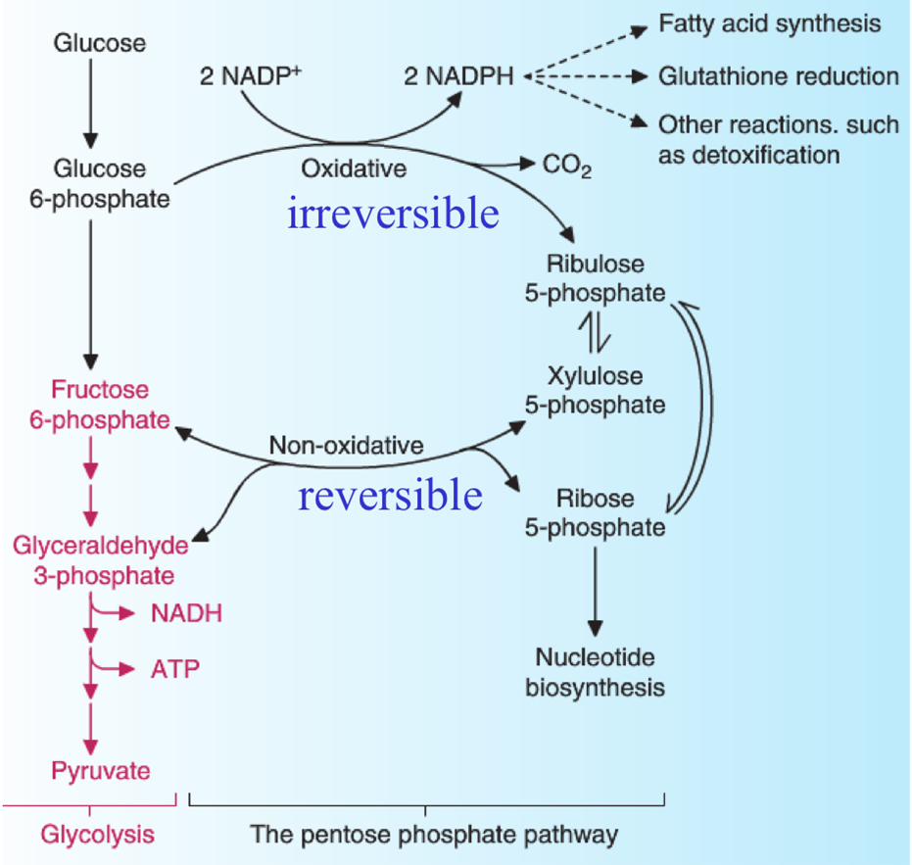
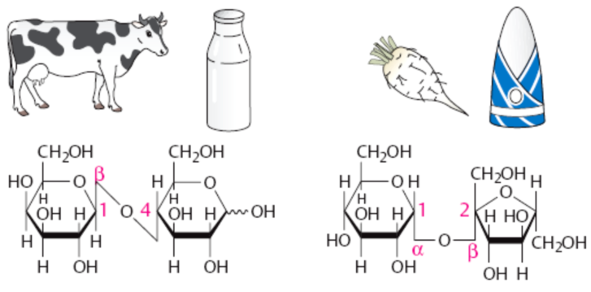
PENTOSE PHOSPHATE PATHWAY
METABOLISM OF FRUCTOSE AND GALACTOSE
Svjetlana Kalanj Bognar, svjetlana.kalanj.bognar@mef.hr

Slide 2
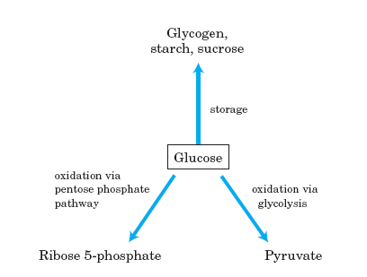
Reminder on major pathways of glucose utilization

Slide 3
PENTOSE PHOSPHATE PATHWAY
Pentose phosphate pathway occurs in cytosol.
Oxidative phase
Formation of NADPH and pentoses; alternative pathway of glucose oxidation without ATP production.
Non-oxidative phase
Transformation of monosaccharides containing 3, 4, 5, 6 and 7 carbon atoms; sequences of transformation reactions are catalyzed by enzymes transketolases and transaldolases.

Slide 4
Majority of cells utilizes approx. 10 % glucose in the pentose phosphate pathway.
Which cells and tissues require more of
pentoses?
NADPH?
a) Rapidly dividing, proliferating cells – bone marrow, skin, intestinal mucosa; pentoses are utilized for synthesis of RNA, DNA, coenzymes ATP, NADH, FADH₂, CoA.
b) Tissues that carry extensive fatty acids and lipid biosynthesis - liver (up to 30% of total glucose oxidation), adipose tissue, mammary gland; tissues which synthesize cholesterol and steroid hormones – liver, adrenal glands, gonads; erythrocytes, leukocytes, the cells of lens and cornea which are directly exposed to oxidative damage (NADPH shows antioxidative effects).

Slide 5

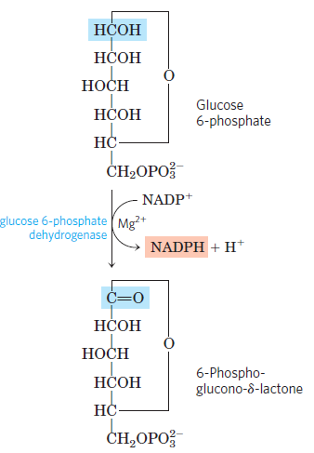
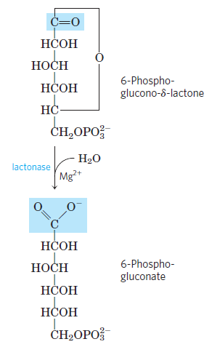
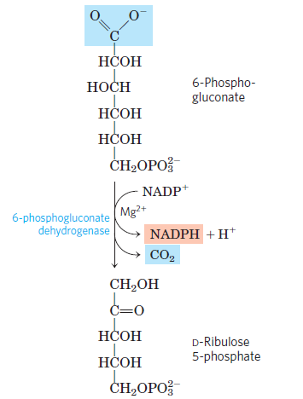
I. Oxidative phase of pentose phosphate pathway
Glucose 6-phosphate-dehydrogenase, G6PD (G6PD is highly specific for NADP⁺, K_{M} for NAD⁺ > K_{M} for NADP⁺)

Slide 6

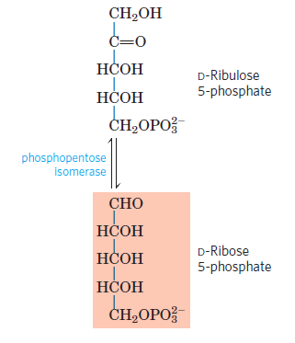
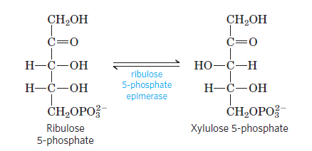
Sum reaction of oxidative phase of pentose phosphate pathway
How is ribulose 5-phosphate utilized further on?
Isomerisation to ribose 5-phosphate
Epimerisation to xylulose 5-phosphate

Slide 7
II. Nonoxidative phase of pentose phosphate pathway
ribose 5-phosphate is converted to glyceraldehide 3-phosphate and fructose 6-phosphate, in reactions catalyzed by enzymes transketolases and transaldolases
reactions of monosaccharide transformations result with formation of two hexoses and one triose from three pentoses (or vice versa)

Slide 8
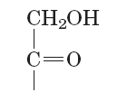
II. Nonoxidative phase of pentose phosphate pathway
reactions of nonoxidative phase of pentose phosphate pathway are reversible; pentoses may be converted to hexoses by reactions in opposite direction
ribose 5-phosphate is converted to intermediates of glycolysis and gluconeogenesis
interconversions of monosaccharides are catalyzed by transketolase and transaldolase
Transketolase – transfer of 2C fragments.
Transaldolase – transfer of 3C fragments.
Monosaccharide donor of C-fragments is ketose, and acceptor is aldose!

Slide 9
II. Nonoxidative phase of pentose phosphate pathway– 1. reaction
CH₂OH
C=O
CH₂OH
CHO
HO-C
-H
C=O
H-
C-OH
H-
C-OH
HO-
C
-H
+
H-
C-OH
H-
C-OH
H-
C-OH
H-
C-OH
Transketolase
H-
C-OH
CH₂OP
CH₂OP
CH₂OP
Xyulose-5-PO₄
xylulose 5-phosphate
Ribose-5-PO₄
ribose 5-phosphate
sedoheptulose 7-phosphate
CHO
H-
C-OH
CH₂OP
glyceraldehide 3-phosphate

Slide 10
II. Nonoxidative phase of pentose phosphate pathway– 2. reaction
CH₂OH
C=O
CH₂OH
CHO
C=O
HO-C
-H
H-
C-OH
HO-C
-H
+
H-
C-OH
CH₂OP
H-
H-
C-OH
C-OH
Transaldolase
H-
C-OH
glyceraldehide 3-phosphate
H-
C-OH
CH₂OP
CH₂OP
sedoheptulose 7-phosphate
fructose 6-phosphate
CHO
H-
C-OH
H-
C-OH
CH₂OP
erythrose 4-phosphate

Slide 11
II. Nonoxidative phase of pentose phosphate pathway– 3. reaction
CH₂OH
CH₂OH
CHO
C=O
CHO
C=O
H-
C-OH
H-
C-OH
+
HO-
C
-H
H-
C-OH
+
HO-C
-H
H-
C-OH
Transketolase
CH₂OP
H-
C-OH
CH₂OP
CH₂OP
glyceraldehyde
3-phosphate
H-
C-OH
xylulose 5-phosphate
CH₂OP
erythrose 4-phosphate
fructose 6-phosphate

Slide 12
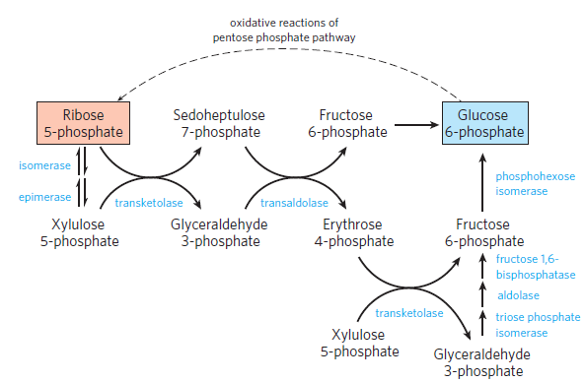
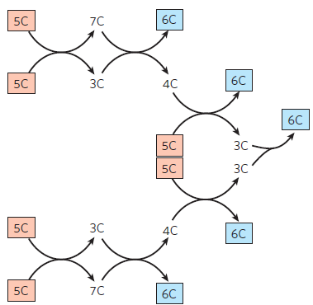

Non-oxidative reactions of pentose phosphate pathway - Summary

Slide 13
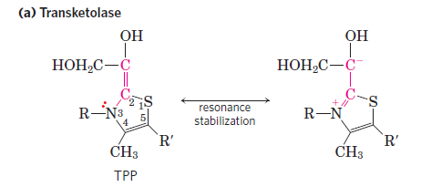
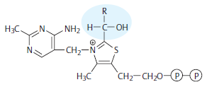
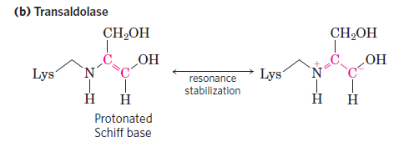
Transketolase needs cofactor thiamine pyrophosphate (TPP, active form of vitamin B₁).
Transaldolase transfers C3-units, no cofactor is needed for enzyme activity.

Slide 14
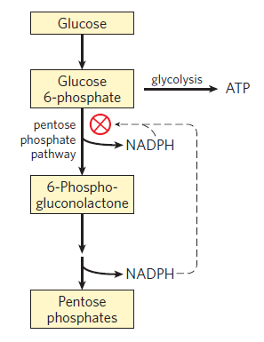
Pentose phosphate pathway regulation:
Reaction catalyzed by glucose 6-phosphate dehydrogenase (G6PD) is irreversible and is the regulatory site of pentose phosphate pathway.
Tissue differences: higher expression of oxidative phase is present in erythrocytes and hepatocytes (higher needs for NADPH) and neglectable in muscles and other cells with low lipid synthesis.

Slide 15
Regulation of pentose phosphate pathway: 1. NADP⁺/NADPH ratio and 2. oxidized/reduced glutathione
NADP⁺ is required for the first reaction of pentose phosphate pathway (enzyme Glc-6-P-dehydrogenase)!
When NADPH is forming faster than it is being used for biosynthesis and glutathione reduction, [NADPH] increases and inhibits the first enzyme in the pentose phosphate pathway. As a result, more glucose 6-phosphate is available for glycolysis.

Slide 16
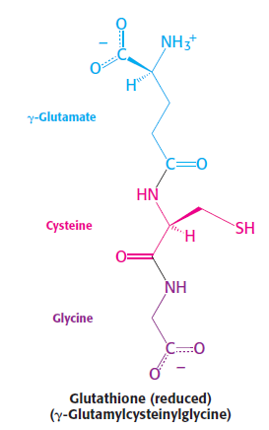
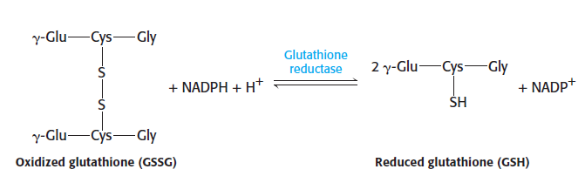
GLUTATHIONE TRIPEPTIDE SEQUENCE
Hemolytic anemia is major symptom in individuals with G6PD enzyme deficiency! Mutation in gene coding for the enzyme is considered as protective mutation – resistance to malaria!

Slide 17
Regulation of pentose phosphate pathway: role of oxidized glutathione
GSSG
Glc-6-P
NADP⁺ is required for the first reaction of pentose phosphate pathway!
Glucose 6-P-dehydrogenase is stimulated by GSSG and glucose 6-phosphate.

Slide 18
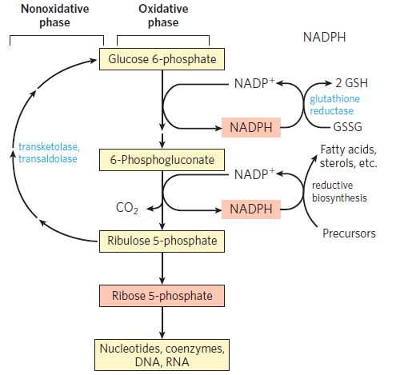
Pentose phosphate pathway - Overview

Slide 19
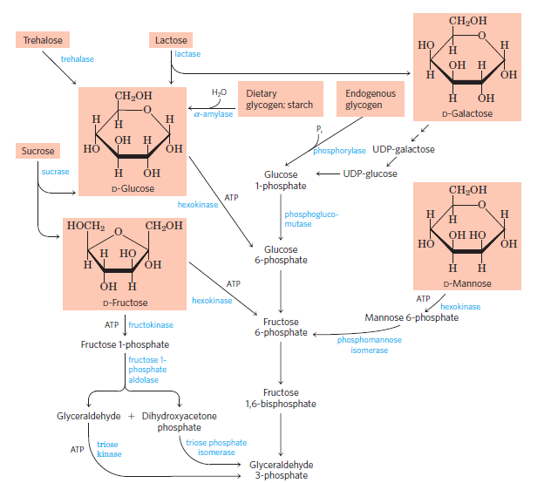
METABOLISM OF FRUCTOSE AND GALACTOSE
Entry of glycogen, starch, disaccharides and hexoses into the preparatory stage of glycolysis.

Slide 20
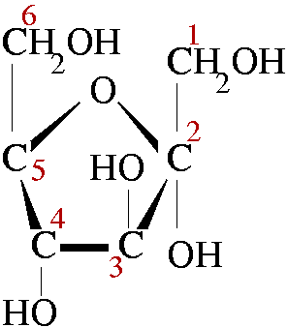
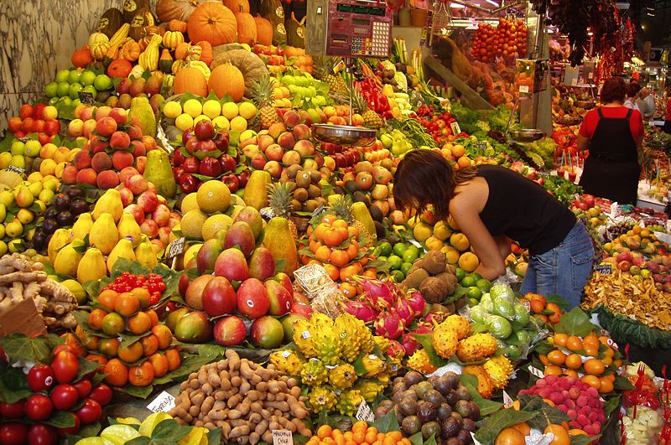
FRUCTOSE METABOLISM
Approximately 100 g daily – dietary sources include fruit, honey, sucrose, high-fructose corn syrup, sweeteners in processed foods and beverages!
Metabolism of fructose differs in muscle and liver!

Slide 21
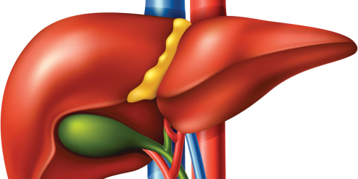
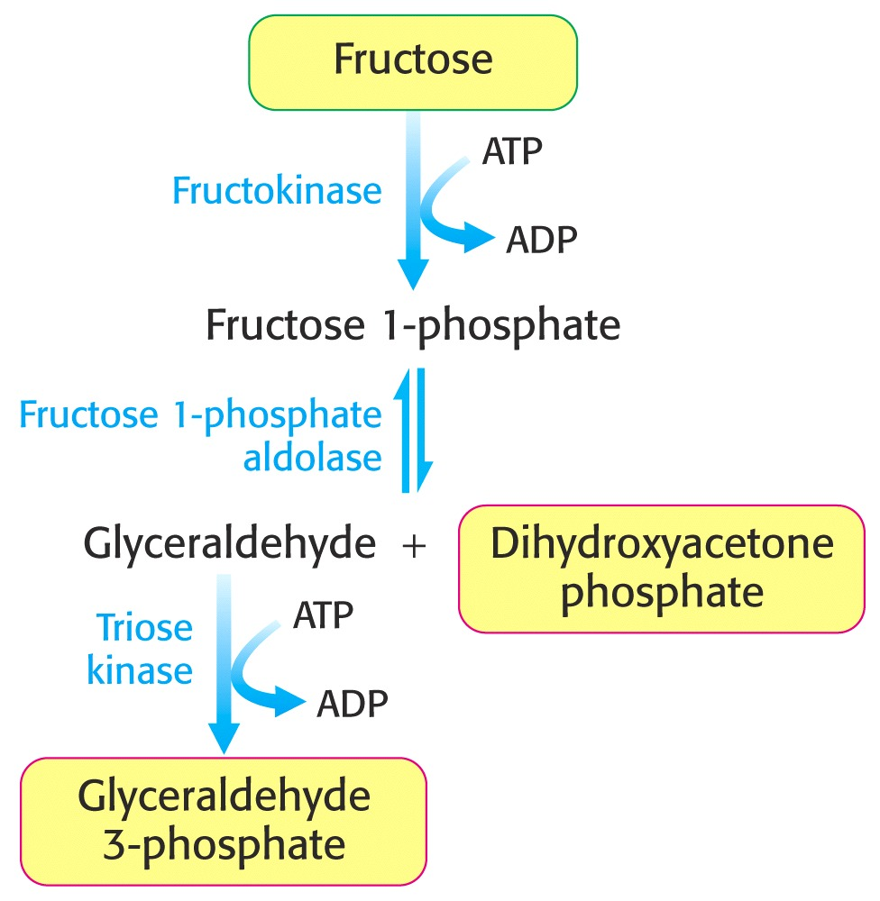
METABOLISM OF FRUCTOSE IN LIVER TISSUE: Fru 1-phosphate pathway
Conversion of fructose 1-phosphate into glycolytic intermediates bypasses two regulatory steps-reactions catalyzed by hexokinase and PFK-1.
Entrance of fructose into glycolytic pathway is essentially unregulated!
(aldolase B)

Slide 22
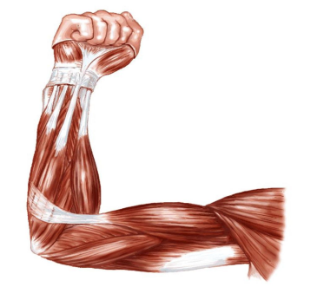
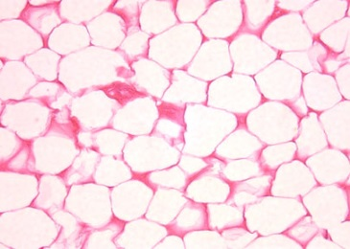
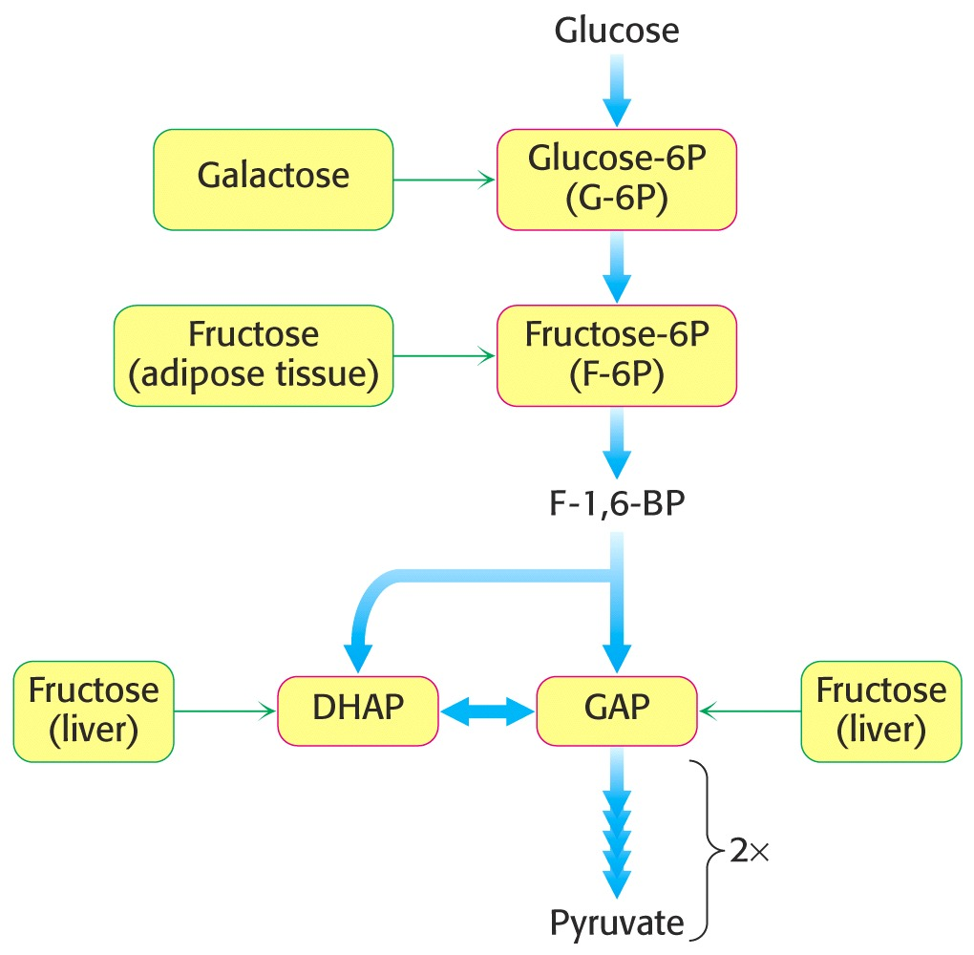
Fructose metabolism in muscle and adipose tissue:
Hexokinase phosphorylates fructose → glycolytic intermediate, fructose 6-phosphate
Hexokinases expressed in muscle and adipose tissue have a low affinity for fructose; the reaction is of minor importance unless fructose consumption is exceptionally high.

Slide 23
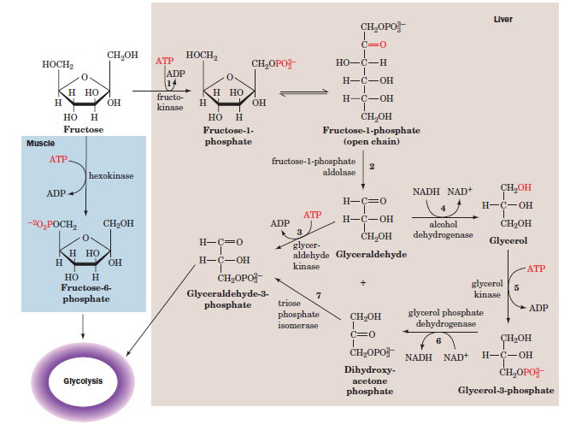
Overview of Fru metabolism

Slide 24

Fructose and sugar alcohol sorbitol - in seminal plasma, acting as energy molecules and influencing sperm motility!
Fructose can be synthesized from glucose via sorbitol –
the enzymes aldose reductase and sorbitol dehydrogenase are expressed in male reproductive tissues.
Aldose reductase
Sorbitol dehydrogenase
Sorbitol – naturally occuring sweetener (apples, pears, peaches, prunes); also found in sugar-free chewing gum, ice cream; may have laxative effects.

Slide 25

Disorders of fructose metabolism
Essential fructosuria – deficiency of hepatic fructokinase; the condition is harmless and asymptomatic.
Hereditary fructose intolerance – deficiency of hepatic aldolase B; a potentially lethal disorder; symptoms: severe hypoglycemia and vomiting following fructose intake, jaundice, hepatomegaly, hepatic failure; hypoglycemia is caused by accumulated fructose 1-phosphate which interferes with glycogenolysis and gluconeogenesis.
Treatment for both disorders: restriction of dietary fructose and sucrose.
3) Hereditary fructose 1,6-bisphosphatase deficiency – leads to impaired gluconeogenesis and hypoglycemia.

Slide 26
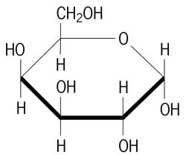
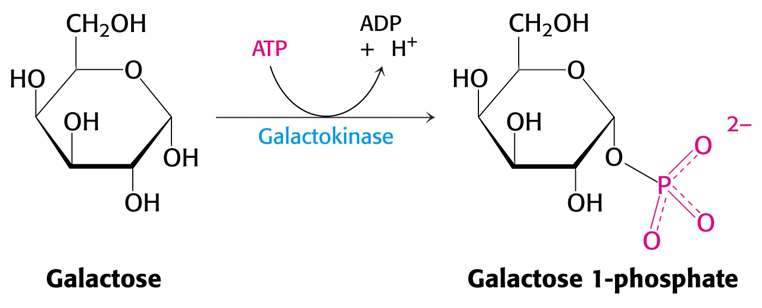
GALACTOSE METABOLISM
Gal is a product of lactose hydrolysis.
Phosphorylation at C-1 produces galactose 1-phosphate by catalyzing action of galactokinase.

Slide 27
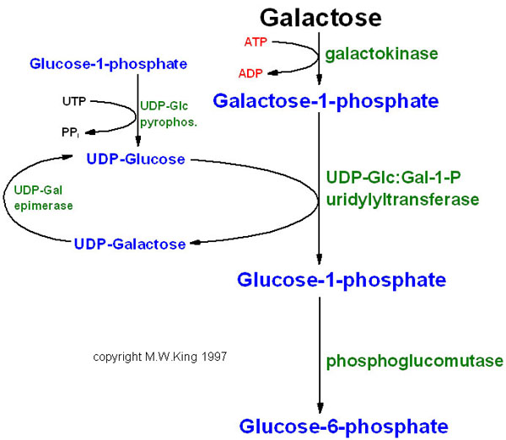
Conversion of UDP-Glc to UDP-Gal is important for synthesis of complex glycoconjugate structures (glycolipids and glycoproteins)!

Slide 28
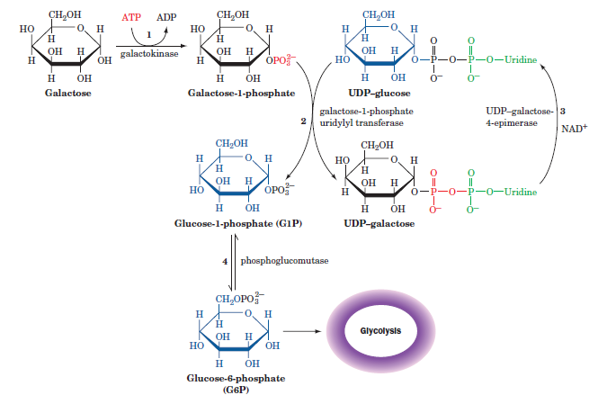
Overview of Gal metabolism

Slide 29
Disorders of galactose metabolism
Galactosemias due to
a) deficiency of galactokinase
b) deficiency of galactose 1-phosphate uridyltransferase
Symptoms: vomiting and diarrhea following milk ingestion; increased blood concentration of galactose, in more severe cases also blindness, liver damage.
2) Deficiency of UDP-galactose 4-epimerase
Treatment for both types of disorders: restriction of dietary galactose.

Slide 30
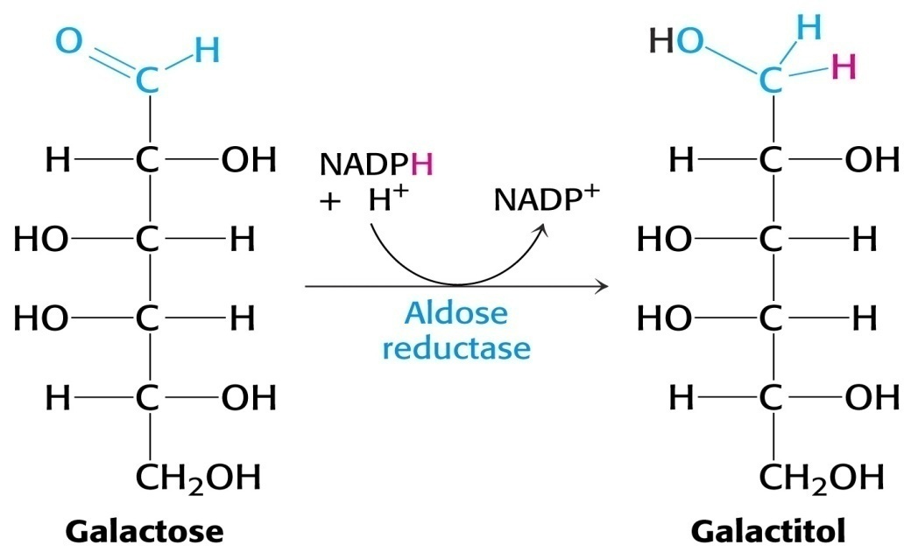
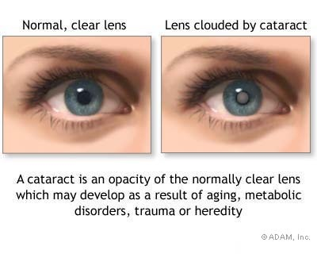
In galactosemias, lens cataract and eventually blindness is related to formation of toxic compound
galactitol.

Slide 31
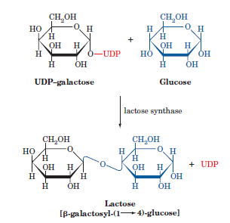
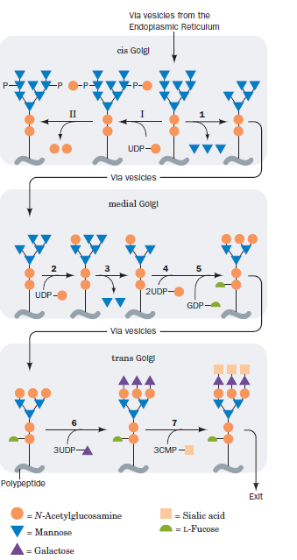
GALACTOSE IS USED FOR LACTOSE SYNTHESIS IN MAMMALS
Lactose production is restricted to the mammary glands. The complete lactose synthase complex includes galactosyl transferase and another non-catalytic subunit, alpha-lactalbumin.
In the presence of alpha-lactalbumin, galactosyl transferase substrate specificity is switched to use glucose, resulting in lactose production rather than N-acetyllactosamine.

Slide 32
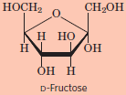
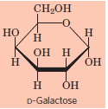
GALACTOSE (Gal)
Gal
↓ galactokinase
Gal-1-phosphate
+ UDP-Glc
↓
Glc-1-phosphate + UDP-Gal
↓ epimerase
UDP-Glc
Glc-6-phosphate
↓
glycolysis
glycoproteins, glycolipids,
lactose synthesis glycogen synthesis
Glucose metabolism/utilization
FRUCTOSE (Fru)
Liver Other tissues
-----------------------------------------------------------------------------
Fru Fru
↓ fructokinase ↓ hexokinase
Fru-1-phosphate Fru-6-phosphate
aldolase ↓
Dihydroxyacetone phosphate ↓
+ Glyceraldehyde glycolysis
↓ glyceraldehyde kinase
Glyceraldehyde 3-phosphate
glycolysis

Slide 33
Literature:.
1. D.L. Nelson i M.M. Cox: Lehninger Principles of Biochemistry, 3rd edition, Worth Publishers, USA, 2000.
2. McKee and McKee: Biochemistry-The Molecular Basis of Life, 3rd edition, Oxford University Press, 2004.
5. J. Koolman i K.H. Roehm: Color Atlas of Biochemistry, 2nd edition, Flexibook, Stuttgart-New York, 2005.
REVIEW QUESTIONS
Represent by structural formulas the regulatory reaction of oxidative part of pentose phosphate pathway.
Explain why NADPH acts as an antioxidant substance.
Is fructose more rapidly metabolized in liver than glucose? Why?

