Slide 1
Metabolism - an overwiev
Professor Daria Pašalić

Slide 2
Course attendance
Mandatory
Over zoom-aplication received with schedule
Follow the presentation at the repository, day by day, according the schedule
Make your notes for discussion with us

Slide 3
Practical part
Manual was uploaded at the repository
PRIOR EACH PRACTICAL STUDENT SHOULD BE AWARE OF THE CONTENT
Following each topic during a zoom-presenatation, we will ask you for solving practical tasks
Tasks should be solved after practical presentation in the real time over the zoom application, according the schedule
Exercises will be evaluated
Students should return their practical reports (filled in the manual)
maximally two hours after the end of real time presentations (to the lecturer responsible for the topic according the schedule) if you have only one practical by day
DEADLINE: until 5 PM each day after the exercises- if you have 2 practical by day
Format of the report:
Student should fill the manual for the particular Exercise and save it in only one pdf format
Name of the pdf document should include the number of exercise (P1, P2…), the surname and first name of the student
Example: P1--Magdić Magda or P-3 Petrović Petar
-report should be send to both lecturers that were responsible for specific practical subject
-any other format will not be acceptable, delay reports will not be acceptable

Slide 4
Exam
Oral exam (online or in live if pandemic situation would be better)
1. Part-eliminatory written exam
Short 5 questions- selected reactions from the major metabolic paths
2. Oral exam

Slide 5
Major topics of the lecture
Metabolism
Anabolic reaction
Catabolic reactions
Amphibolyc reactions
Steady state
Energy
Homeostasis; glucohomestasis

Slide 6
Digestion Cellular metabolism hydrolytic reactions in digestive tract all types of metabolic reactions in cell
Living organisms need constant changes and availability of free energy
for mechanic work (i.e. muscle contractions);
Active transport (molecules, ions)
Biosynthesis of macromolecules and other biomolecules from simple precursors
The processes listed below require free energy that hold organism far away from equilibrium,
Living organisms provides the energy from surroundings or form intracellular chemical reactions
Phototrophic: sunlight,
chemotrophic organisms: food oxidation

Slide 7
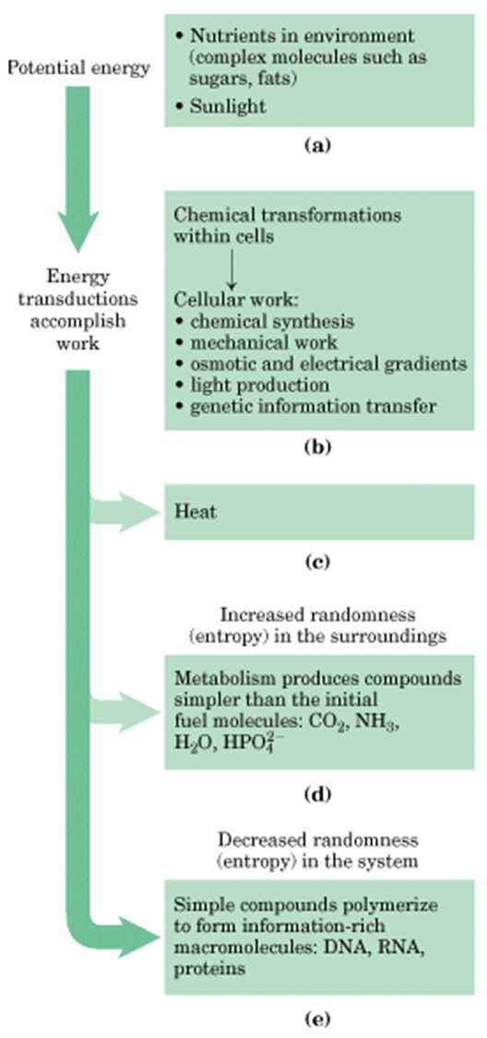
Catabolism
Anabolism

Slide 8
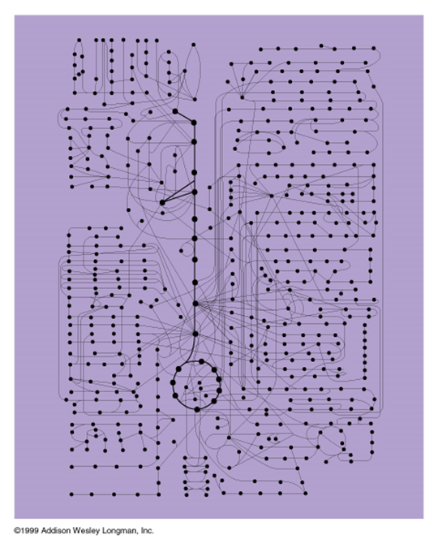
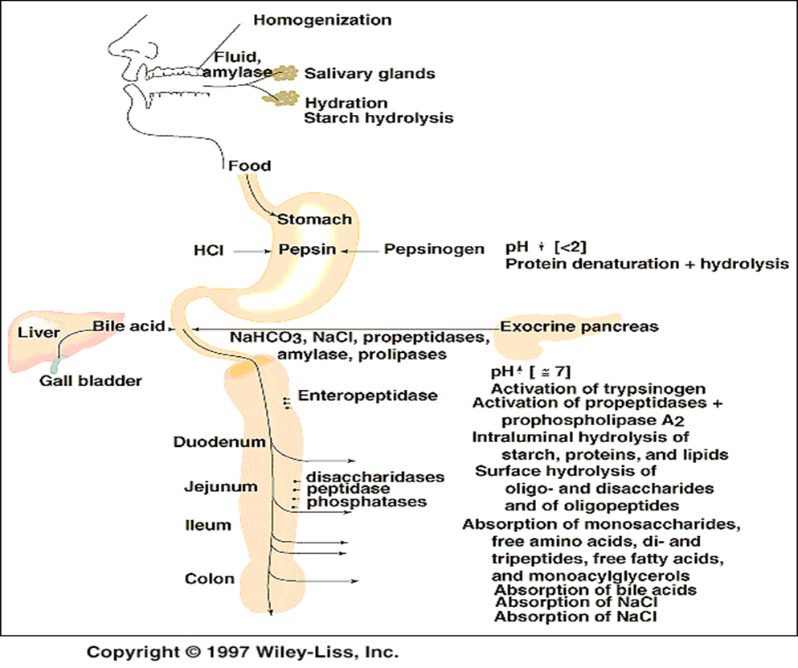
Digestion
hydrolytic reactions in digestive tract
Cellular metabolism
all types of metabolic reactions in cell

Slide 9
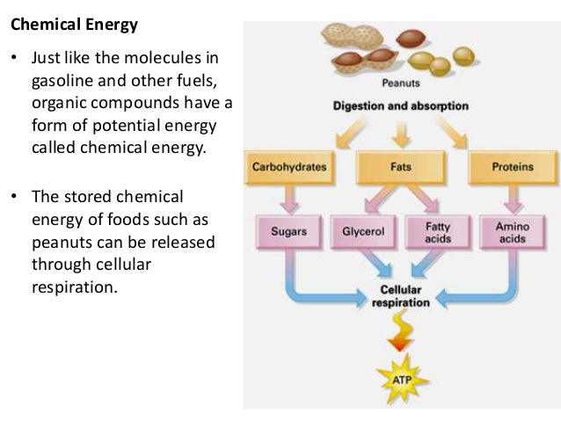
https://www.slideshare.net/GregScrivin/2016-cellular-respiration-and-photosynthesis

Slide 10
(which include glycolysis, citric acid cycle and electron transfer chain)
https://www.slideshare.net/GregScrivin/2016-cellular-respiration-and-photosynthesis

Slide 11
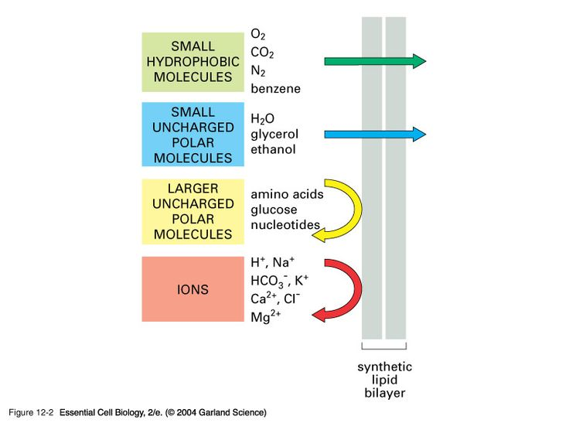
Membrane permeabilty
Just a membrane- without transporters
http://www.wiley.com/college/pratt/0471393878/student/animations/membrane_transport/index.html
section 3

Slide 12
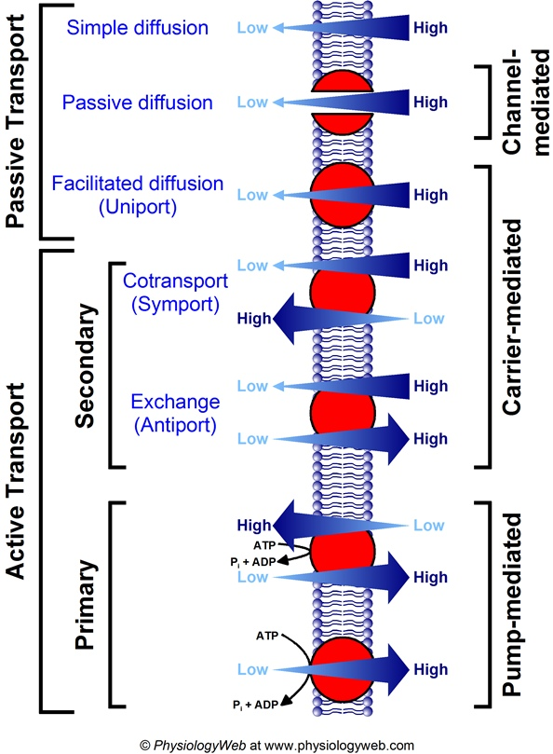

Slide 13
Metabolism
is the set of life-sustaining chemical transformations within the cells of organisms
Manages and establishes the relationships between the bio-macromolecules of the energy state within the cell
Catabolic pathways
Anaboliyc pathways
Amphybolyc

Slide 14
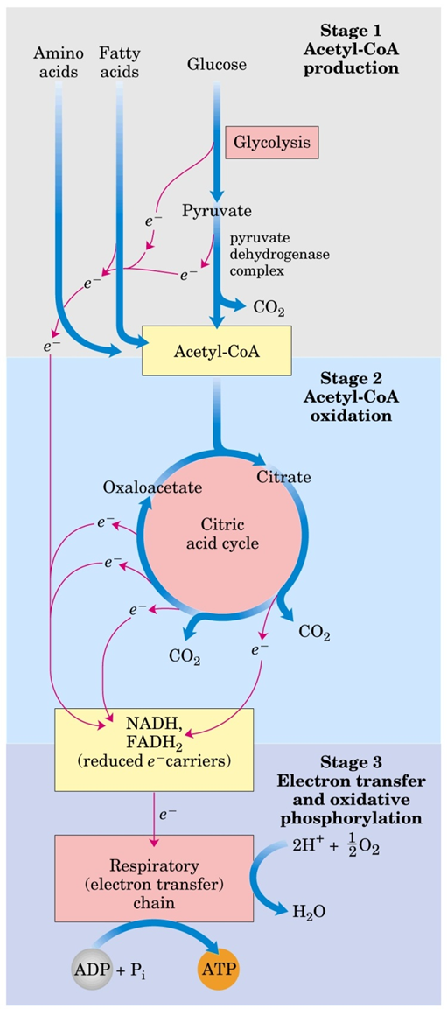
Catabolism
the breakdown of complex molecules in living organisms to form simpler ones, together with the release of energy; destructive metabolism
Enables releasing of reductive elements for cellular respiration
C₆H₁₂0₆ + 6O₂→6CO₂ +6H₂0 + energy
D. L. Nelson, M. M. Cox: Lehninger Principles of Biochemistry,Worth Publishers; New York 2006.

Slide 15
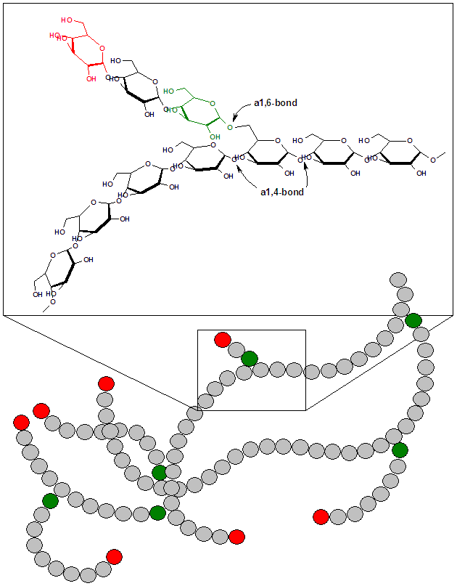
Anabolism
the synthesis of complex molecules in living organisms from simpler ones together with the storage of energy; constructive metabolism.
polimerization

Slide 16
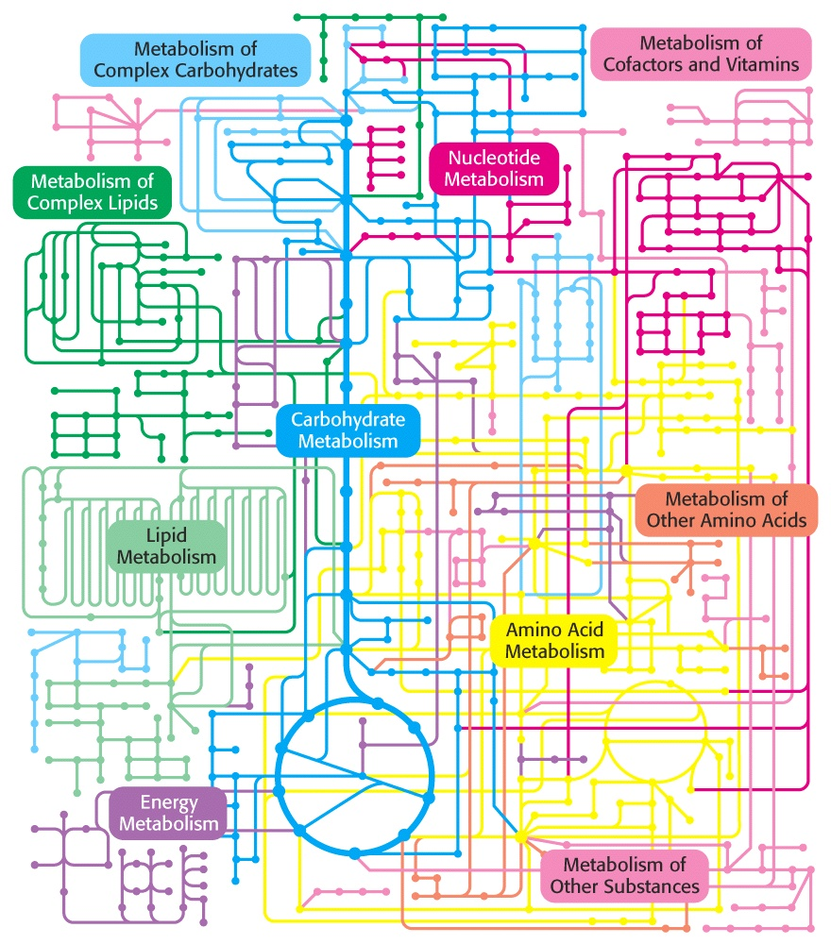
Metabolic reactions

Slide 17
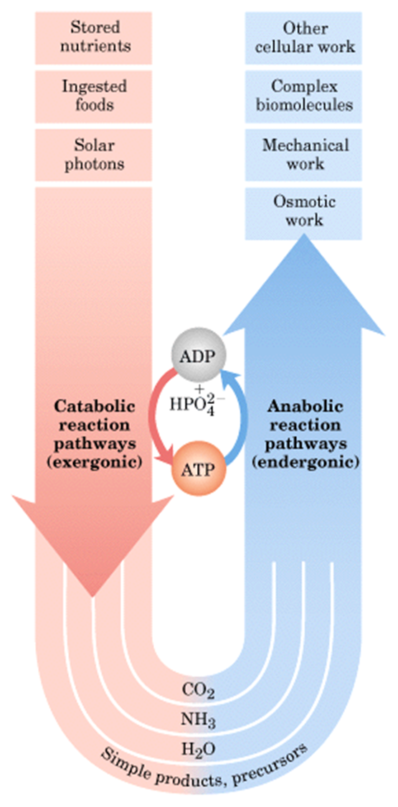
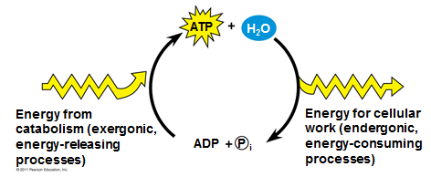

Slide 18
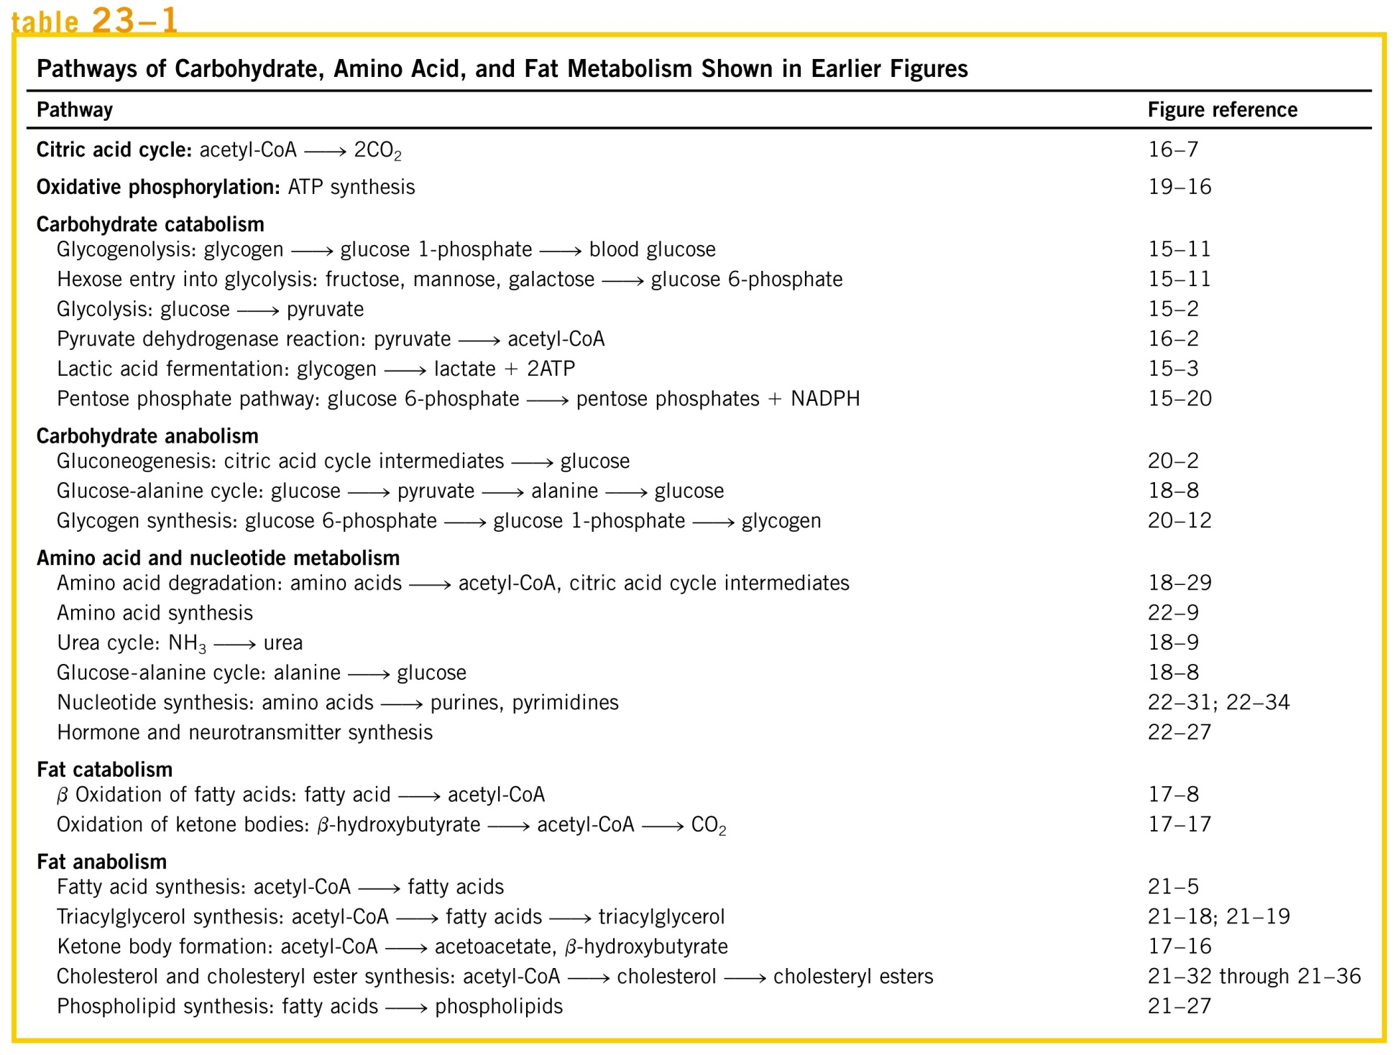
D. L. Nelson, M. M. Cox: Lehninger Principles of Biochemistry,Worth Publishers; New York 2006.

Slide 19
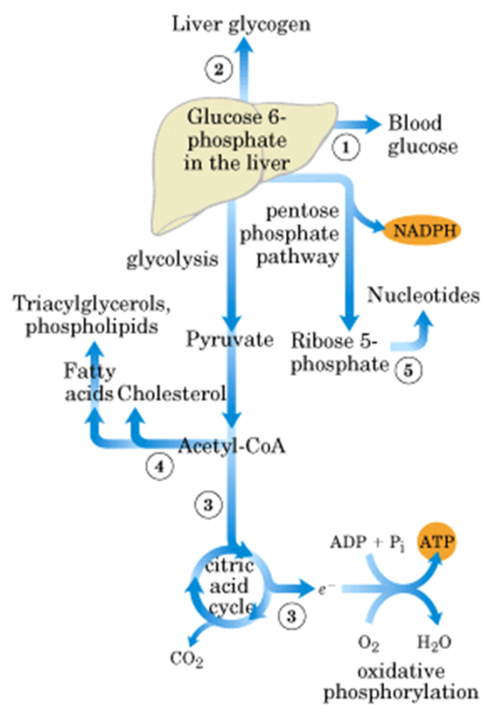
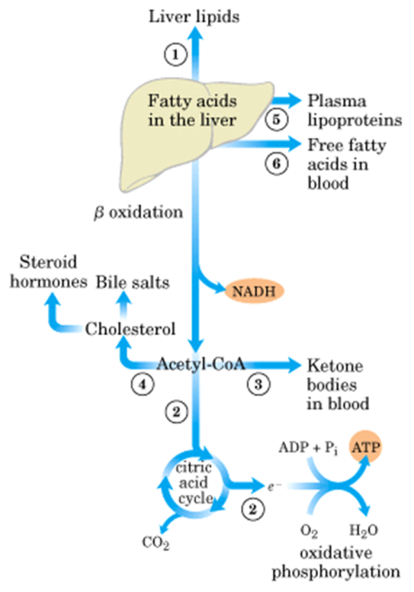
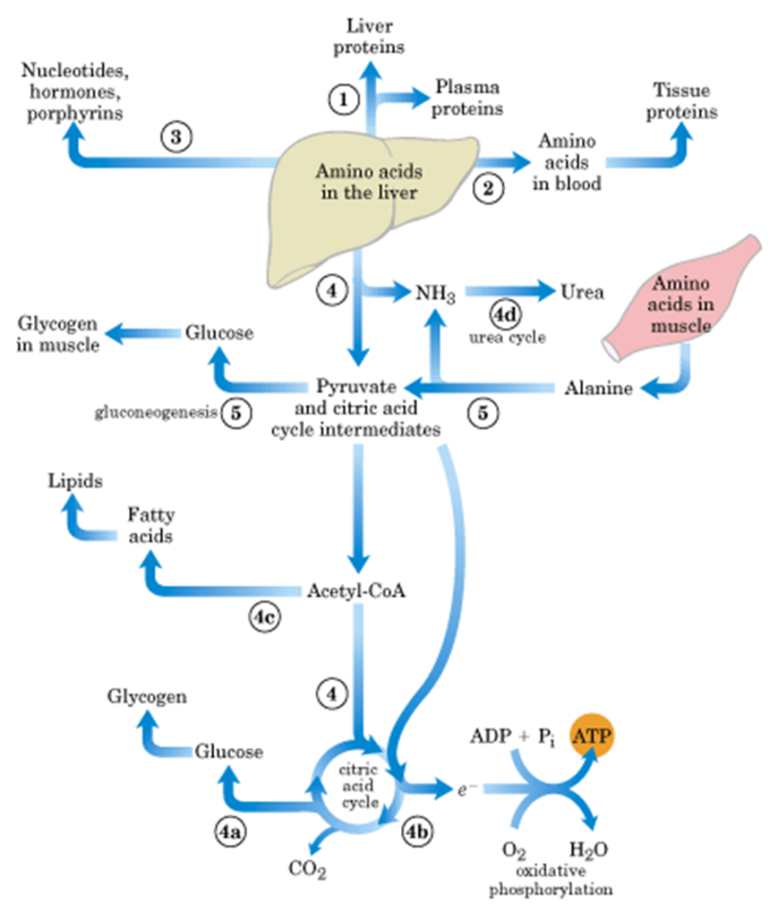
LIVER

Slide 20
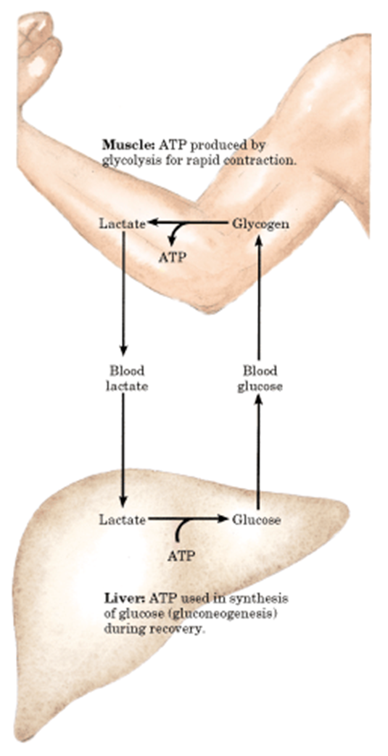
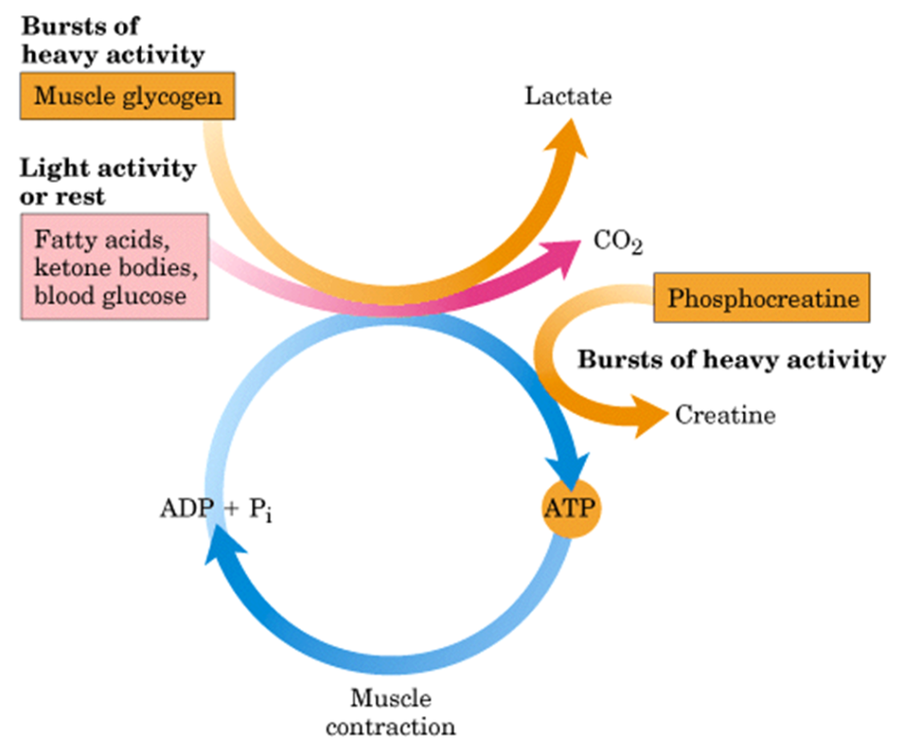
muscles
D. L. Nelson, M. M. Cox: Lehninger Principles of Biochemistry,Worth Publishers; New York 2006.

Slide 21
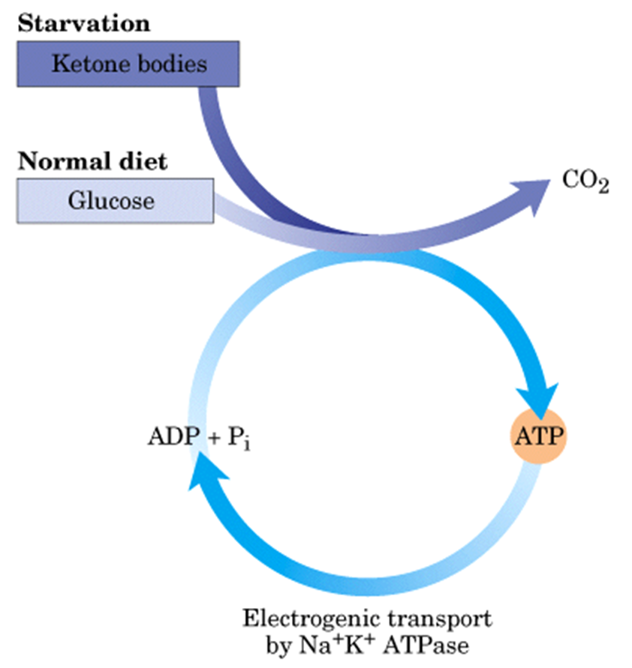
brain
D. L. Nelson, M. M. Cox: Lehninger Principles of Biochemistry,Worth Publishers; New York 2006.

Slide 22
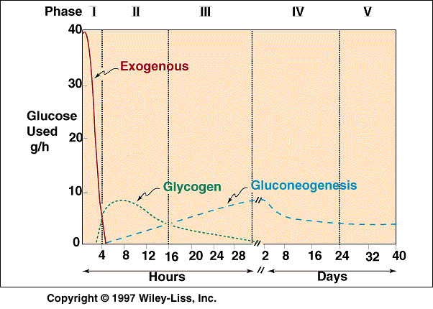
T. E. Devlin: Textbook of Biochemistry with Clinical Correlations, John Wiley and Sons Inc., 2002

Slide 23
D. L. Nelson, M. M. Cox: Lehninger Principles of Biochemistry,Worth Publishers; New York 2006.
McKee T. and McKee J.R.: Biochemistry: The Molecular Basis of Life. 4th Ed., Oxford University Press, 2009
Stryer, Biochemistry, W. H. Freeman, New York, 2006.
T. E. Devlin: Textbook of Biochemistry with Clinical Correlations, John Wiley and Sons Inc., 2002

