Slide 1
Integration of metabolism
Professor Daria Pašalić, PhD

Slide 2
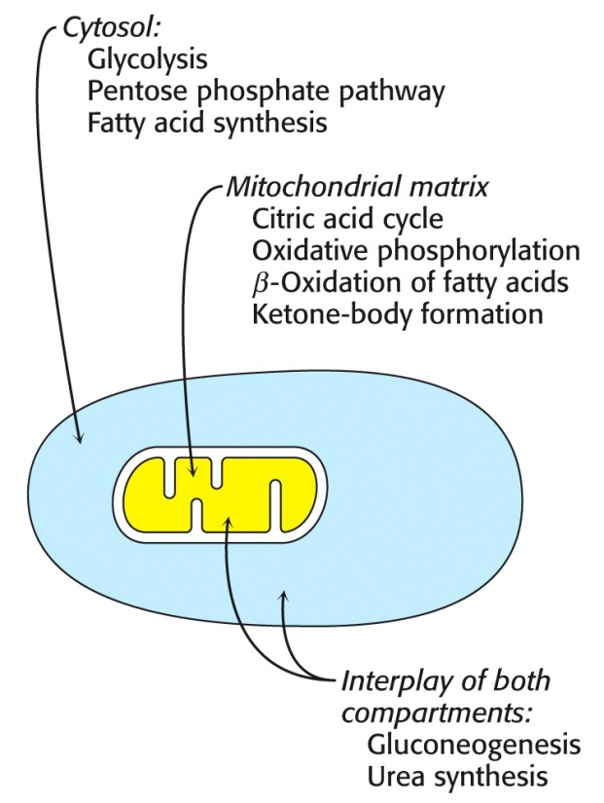
Integration of metabolism-Connection of Pathways
ATP is the universal currency of energy
ATP is generated by oxidation of glucose, fatty acids, and amino acids ; common intermediate -> acetyl CoA ; electron carrier -> NADH and FADH₂
NADPH is major electron donor in reductive biosynthesis
Biomolecules are constructed from a small set of building blocks
Synthesis and degradation pathways almost always separated -> Compartmentation !!!

Slide 3
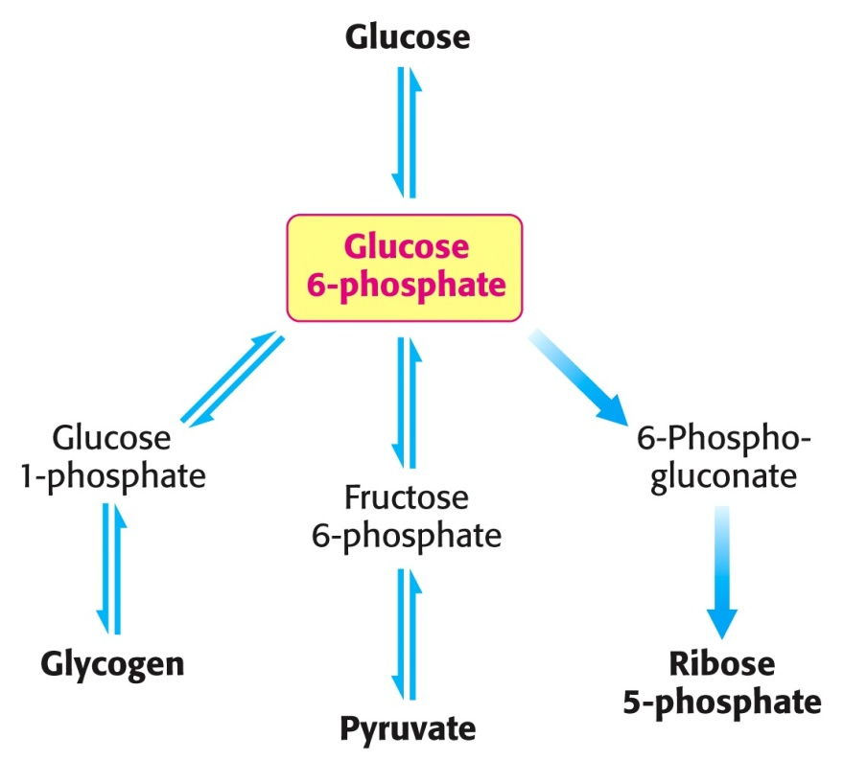
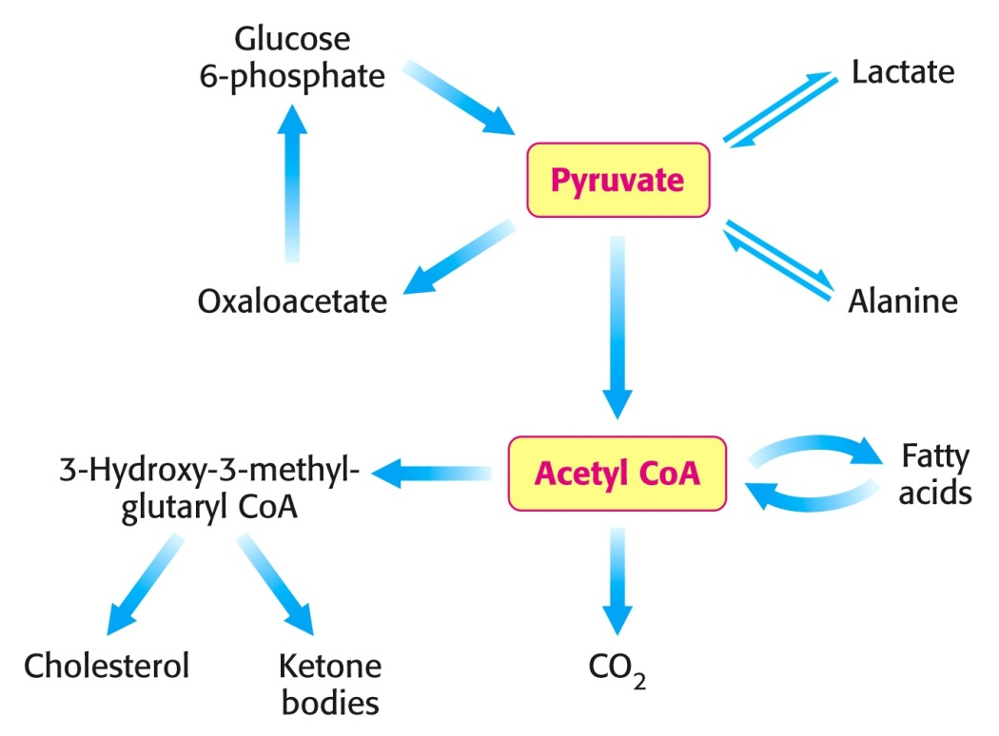
Key Junctions between Pathways

Slide 4
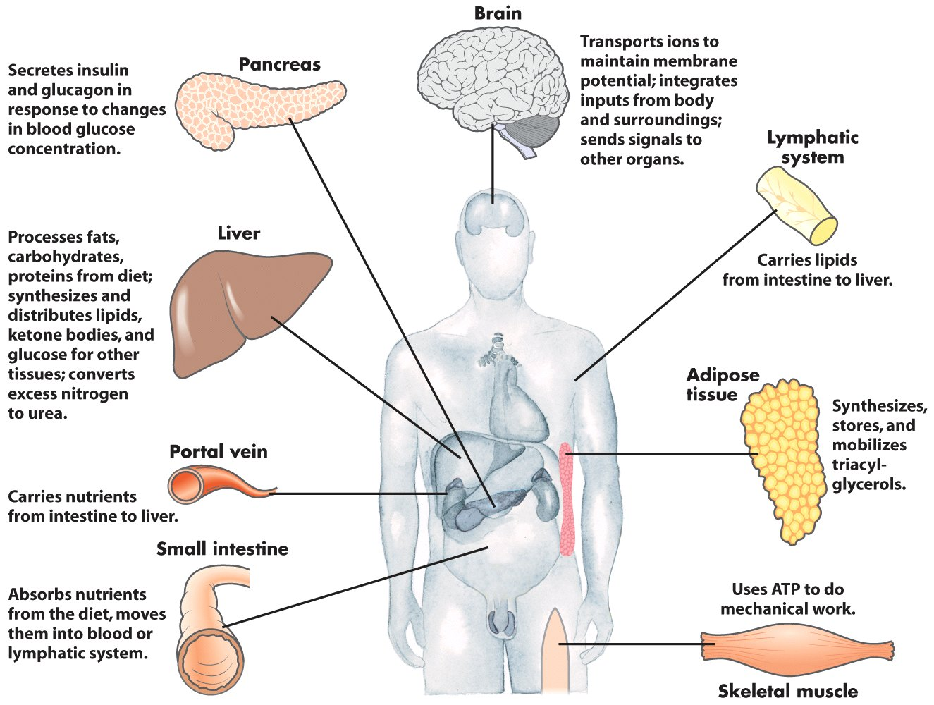
Metabolic Profile of Organs

Slide 5
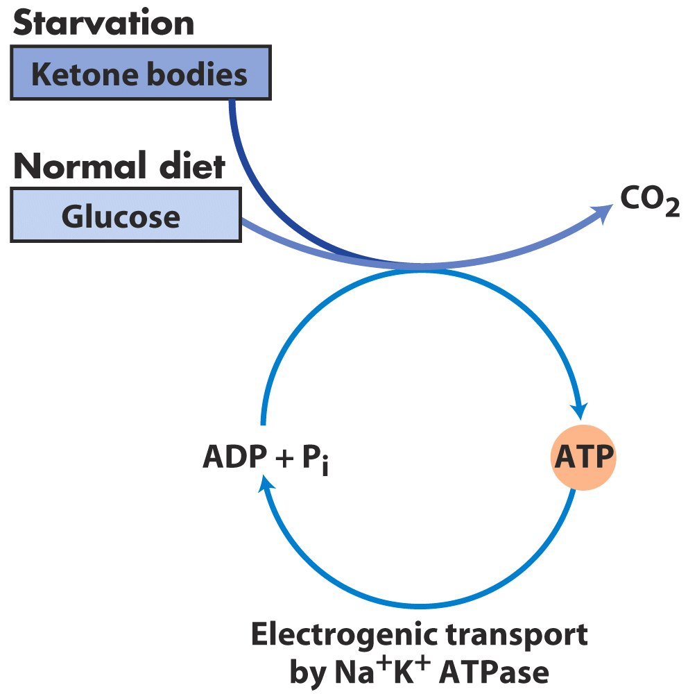
1. Metabolic Profile of Brain
Glucose is fuel for human brain -> consumes 120g/day -> 60-70 % of utilization of glucose
in starvation -> ketone bodies can replace glucose

Slide 6
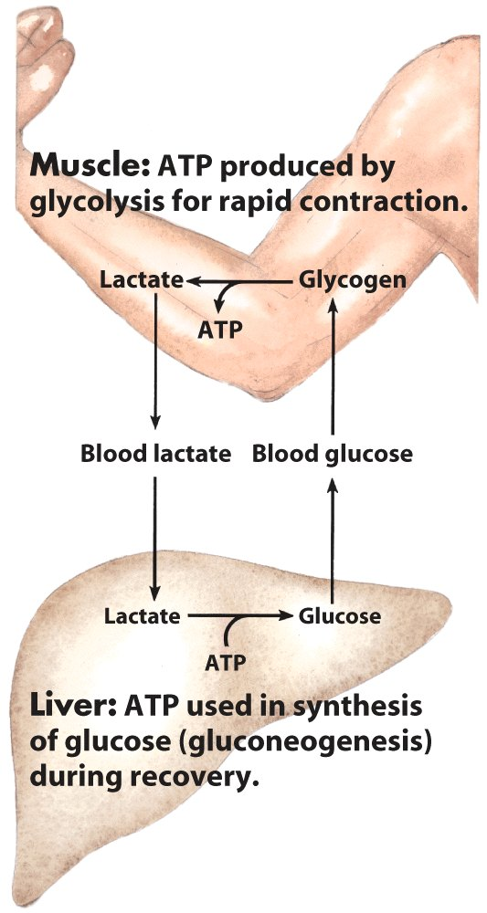
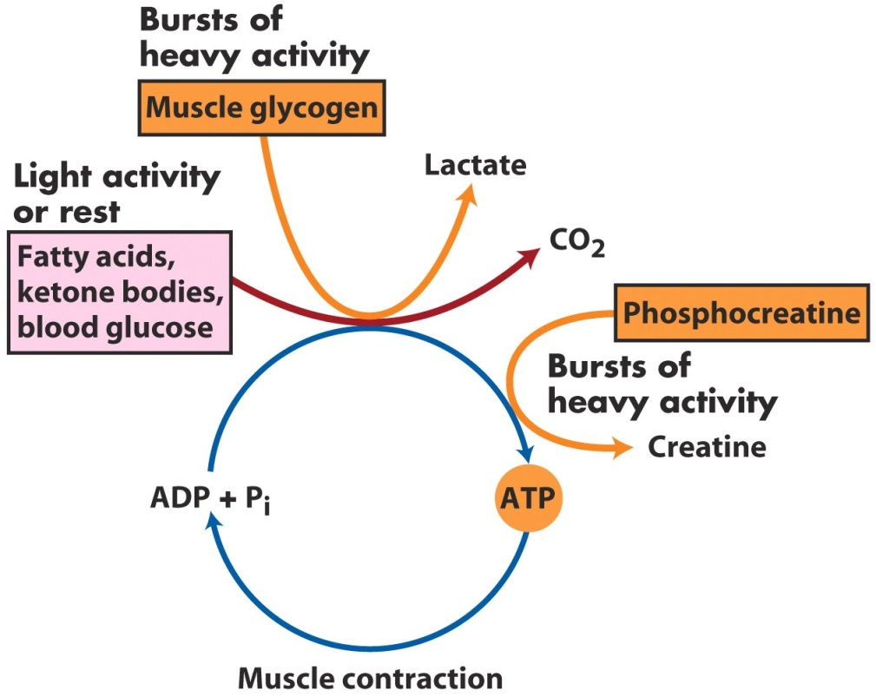
2. Metabolic Profile of Muscles
Major fuels are glucose, fatty acids, and ketone bodies
-> has a large storage of glycogen -> about ¾ of all glycogen stored in muscles
-> glucose is preferred fuel for burst of activity -> production of lactate (anaerobe)
-> fatty acid major fuel in resting muscles and in heart muscle (aerobe)

Slide 7
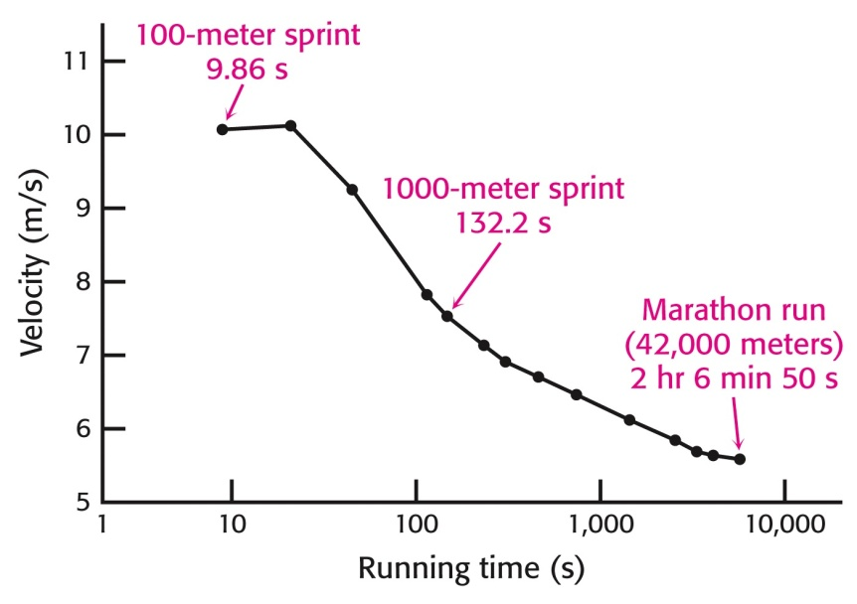
Fuel Choice During Exercise
Fuels used are different in:
-> sprinting -> anaerobic exercise -> lactate
-> distance running -> aerobic exercise -> CO₂
ATP directly powers myosin -> responsible for muscle contraction -> movement
-> amount of ATP in muscle is small
-> velocity depended on rate of ATP production
-> creatine phosphate generates ATP under intense muscle contractions for 5-6 s
Sprint: powered by ATP, creatine phosphate, and anaerobic glycolysis of glycogen -> lactate
Medium length sprint: complete oxidation of muscle glycogen -> CO₂ (production slower) -> velocity lower
Marathon: complete oxidation of muscle and liver glycogen -> CO₂
and complete oxidation of fatty acids from adipose tissues -> CO₂ (ATP is generated even slower)
Low blood-glucose level -> high glucagon/insulin ratio -> mobilization of fatty acids

Slide 8
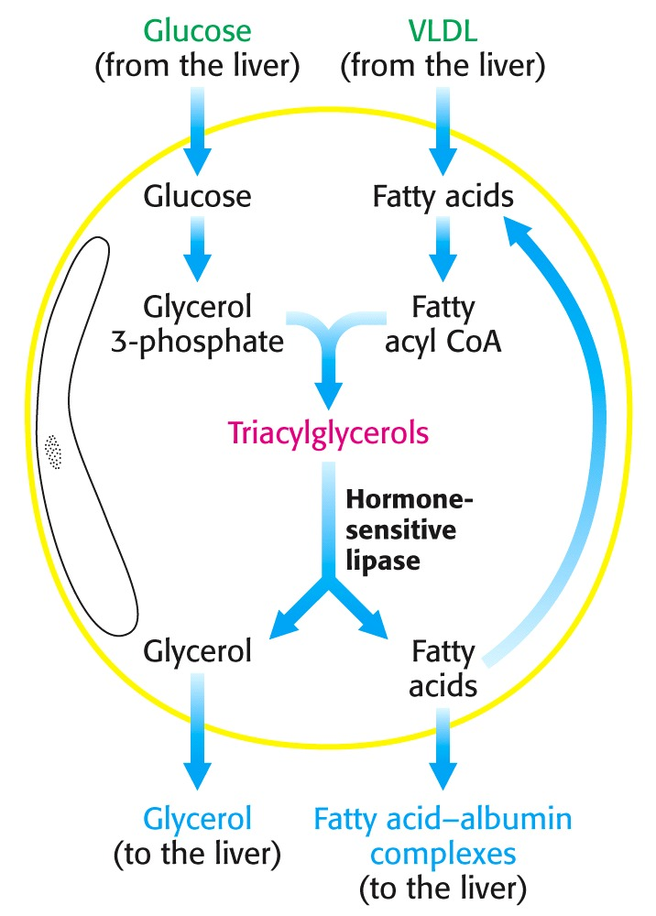
3. Metabolic Profile of Adiposite tissue
Triacylglycerols are stored in tissue -> enormous reservoir of metabolic fuel
-> needs glucose to synthesis TAG;
-> glucose concentration determines if fatty acids are released into blood

Slide 9
4. Metabolic Profile of Kidney
Production of urine -> secretion of waste products
Blood plasma is filtered (60 X per day) -> water and glucose reabsorbed
-> during starvation -> important site of gluconeogenesis (1/2 of blood glucose)

Slide 10
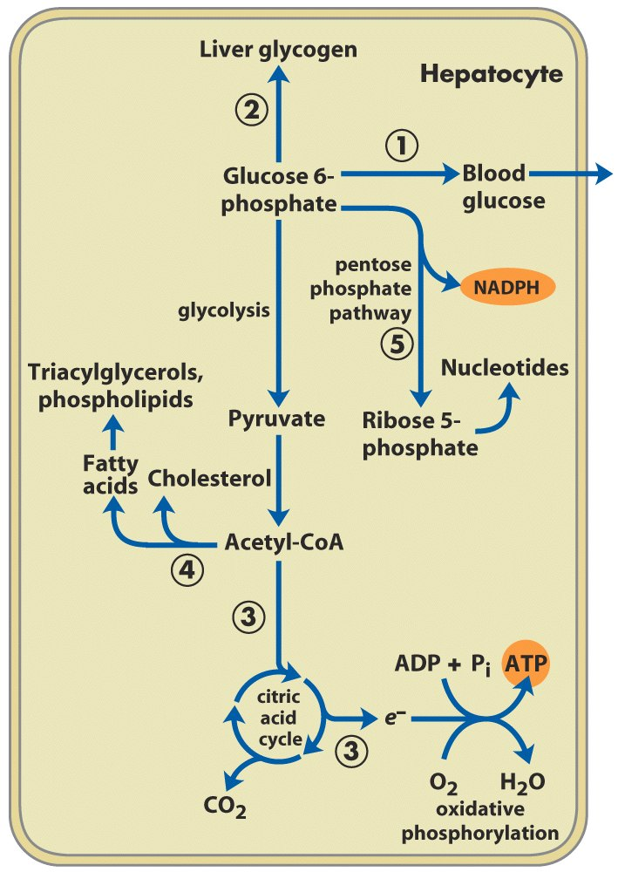
5. Metabolic Profile of the Liver (Glucose)
Essential for providing fuel to brain, muscle, other organs
-> most compounds absorpt by diet
-> pass through liver -> regulates metabolites in blood

Slide 11
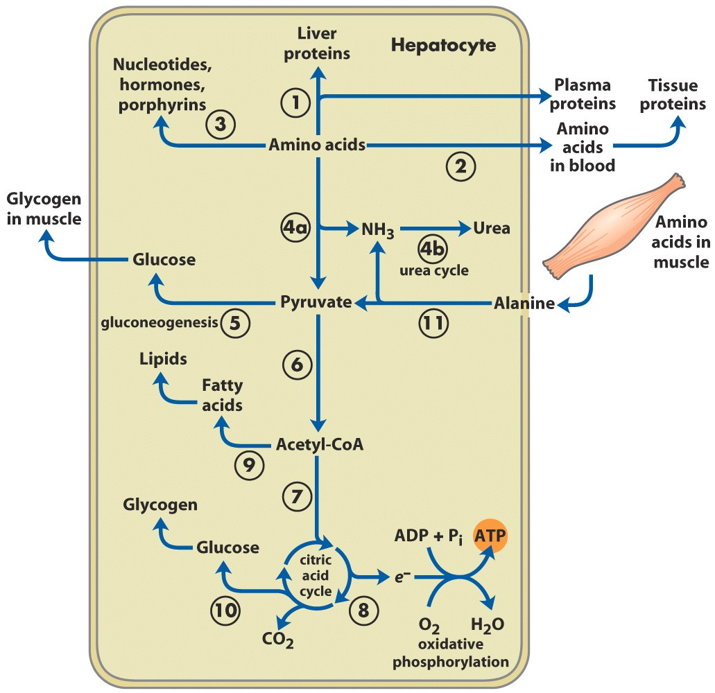
Metabolic Activities of the Liver (Amino Acids)
α-Ketoacids (derived from amino acid degradation)
-> liver’s own fuel

Slide 12
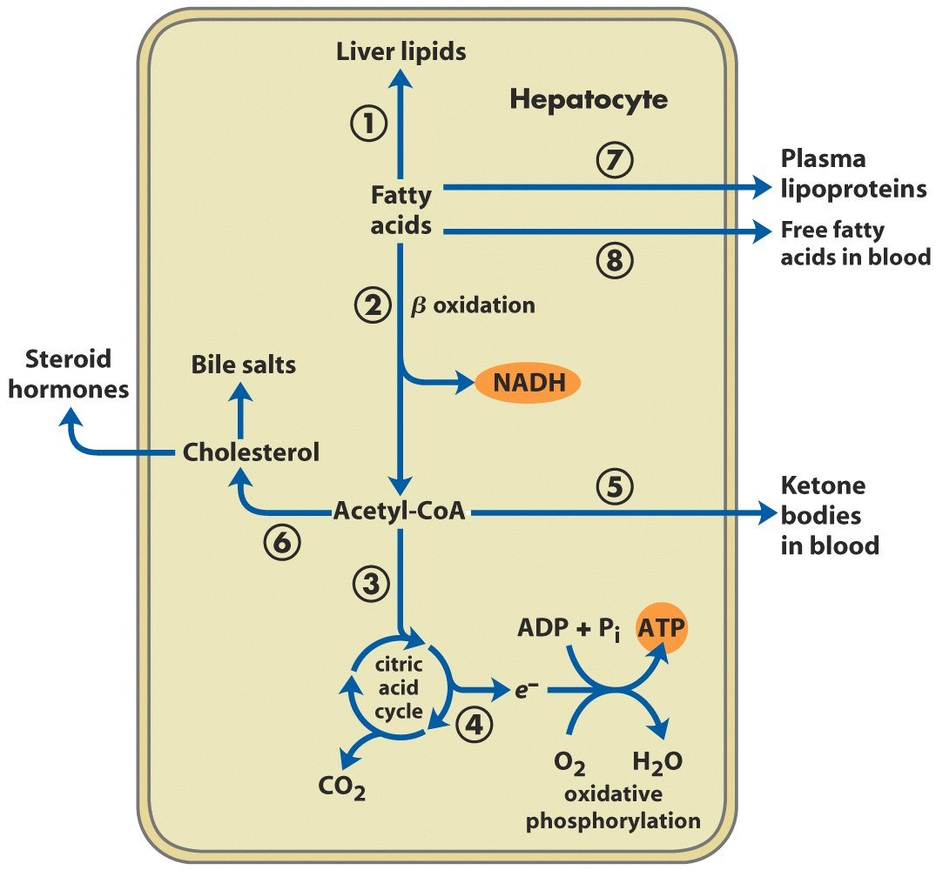
Metabolic Activities of the Liver (Fatty Acids)
cannot use acetoacetate as fuel -> almost no transferase to generate acetyl-CoA

Slide 13
Tissue-Specific Metabolism during the Fed-Fast Cycle
Stages of fed-fast cycle
Fed state - lasts 3 hours after meal ingestion
Postabsorptive/early fasting state - 3 to 12-18 hours after meal
Fasting state - 18 hours to 2 days after meal when nothing else eaten
Starvation/long-term fast - fully adapted to deprivation (weeks)
Refeeding state

Slide 14
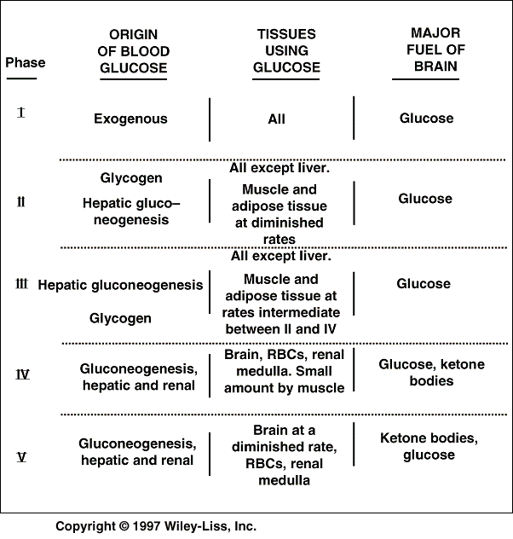
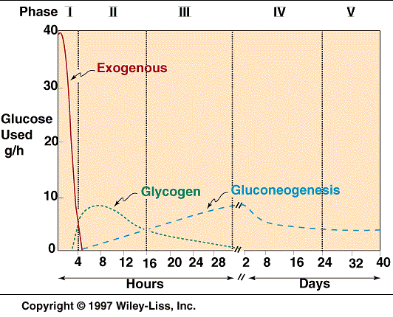
Phases Fed-Fast Cycle

Slide 15
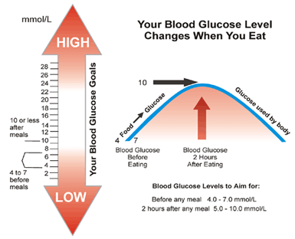

Slide 16
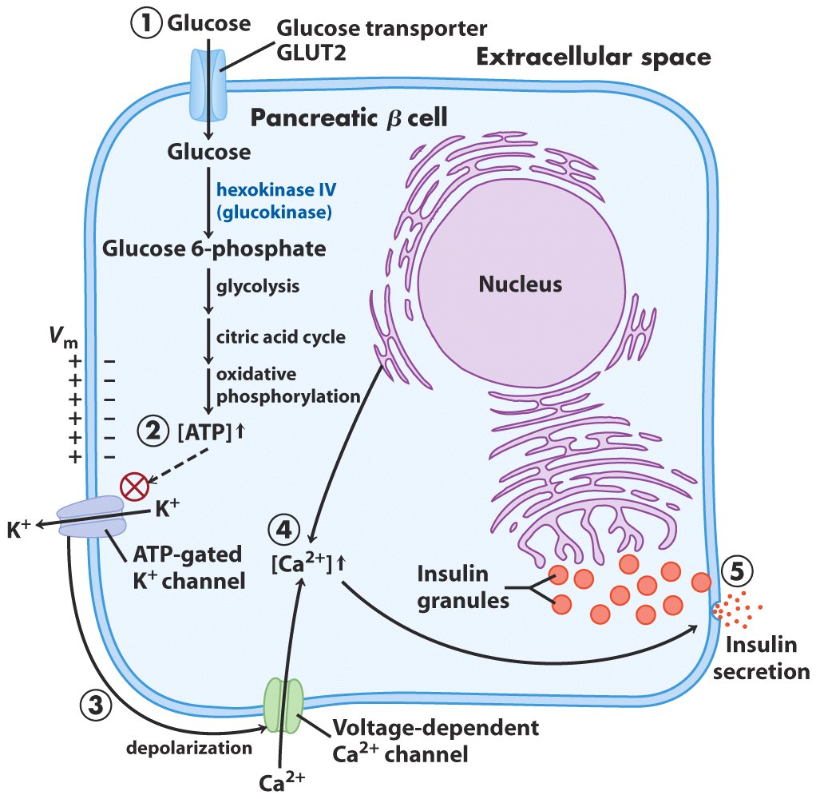
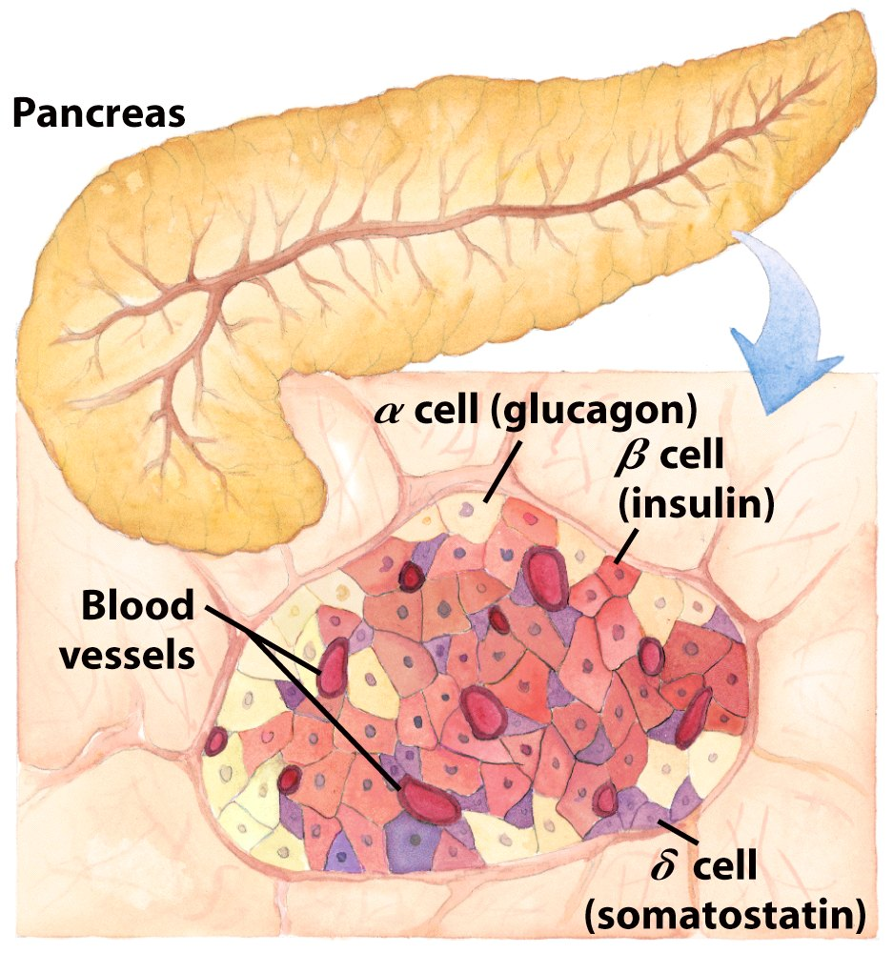
Postabsorptive state
Insulin Secretion –Stimulated by Glucose Uptake
Notes:
.

Slide 17
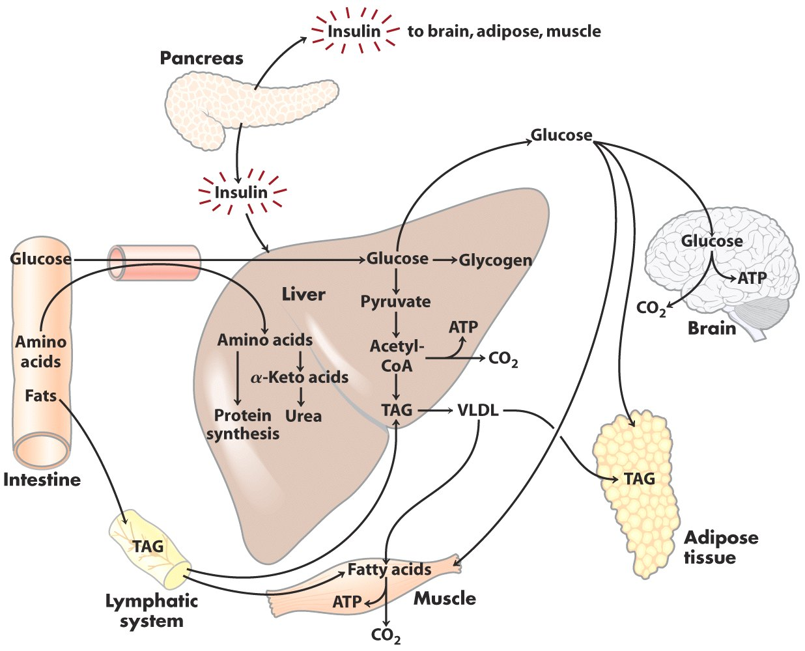
Postabsorptive State -> after a Meal

Slide 18
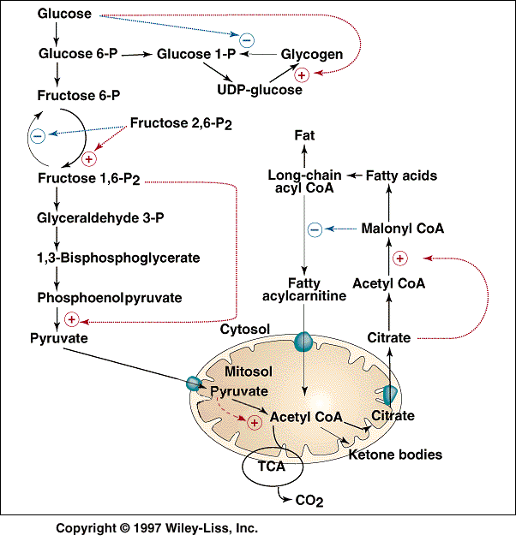
Control of hepatic metabolism in the well-fed state by allosteric effectors

Slide 19
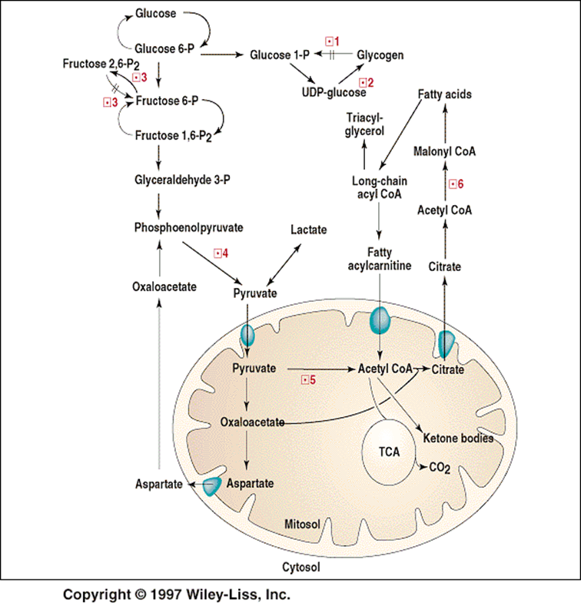
Activity and state of phosphorylation of enzymes subject to covalent modification in the lipogenic liver

Slide 20
2. Early Fasting State
Blood-glucose level drops after several hours after the meal -> decrease in insulin secretion -> rise in glucagon secretion
Low blood-glucose level -> stimulates glucagon secretion of α-cells of the pancreas
Glucagon:
-> signals starved state
-> mobilizes glycogen stores (break down)
-> inhibits glycogen synthesis
-> main target organ is liver
-> inhibits fatty acid synthesis
-> stimulates gluconeogenesis in liver
-> large amount of glucose in liver released to blood stream -> maintain blood-glucose level
Muscle + Liver use fatty acids as fuel when blood-glucose level drops

Slide 21
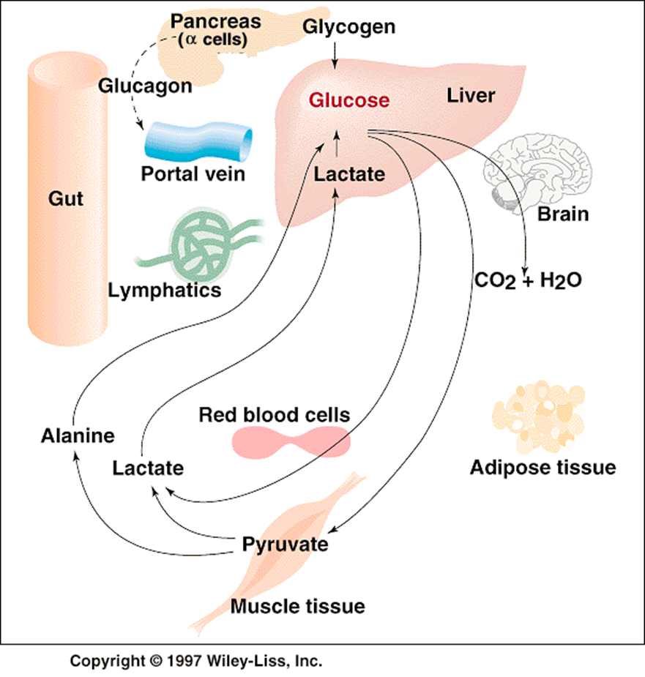
Early Fasting State

Slide 22
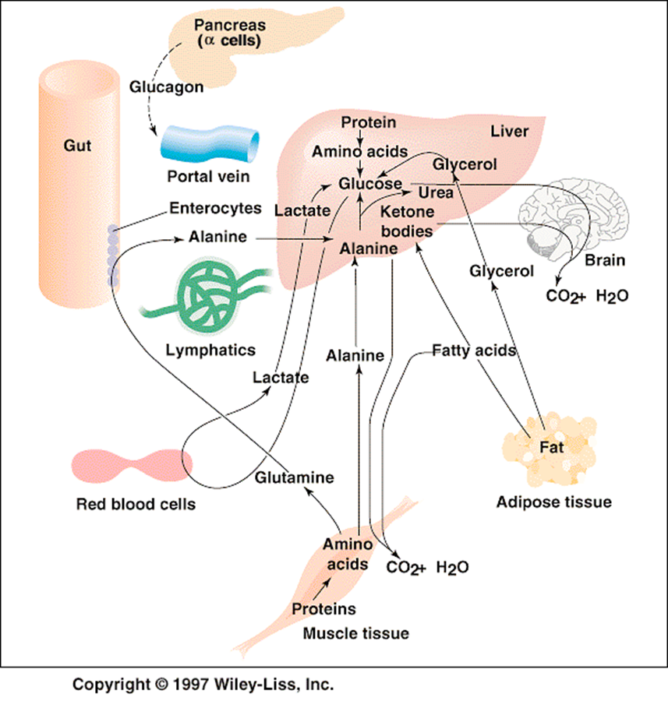
Fasting State

Slide 23
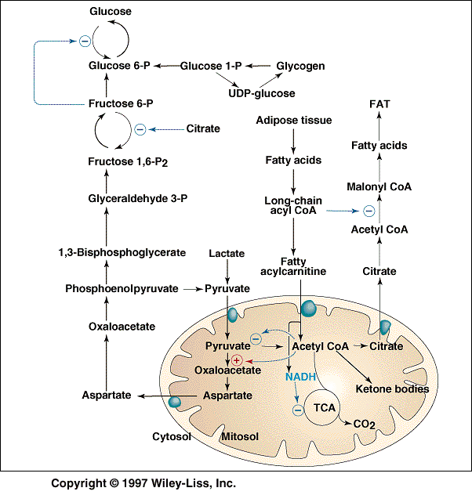
Control of hepatic metabolism in the fasting state by allosteric effectors

Slide 24
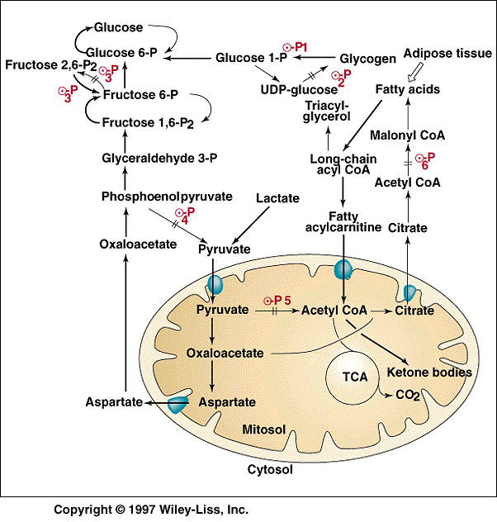
Activity and state of phosphorylation of enzymes subject to covalent modification in the glucogenic liver

Slide 25
Refeed State
Fat is processed in same way as normal fed state
First -> Liver does not absorb glucose from blood (diet)
Liver still synthesizes glucose to refill liver’s glycogen stores
When liver has refilled glycogen stores + blood-glucose concentration still rises -> liver synthesizes fatty acids from excess glucose

Slide 26
Diabetes Mellitus – Insulin Insufficiency
Characterized by: -> high blood-glucose level
-> Glucose overproduced by liver
-> glucose underutilized by other organs
-> shift in fuel usage from carbohydrates to fats -> keton bodies (shortage of oxaloacetate)
-> high level of keton bodies -> kidney cannot balance pH any more -> lowered pH in blood and dehydration -> coma
Type I diabetes: insulin-dependent diabetes (requires insulin to live)
Lack of insulin due to autoimmune destruction of β-cells
begins before age 20
-> insulin absent -> glucagon present
-> person in biochemical starvation mode + high blood-glucose level
-> entry of glucose into cells is blocked (myocytes and adipocytes)
-> glucose excreted into urine -> also water excreted -> feel hungry + thirsty
Type II diabetes: insulin-independent diabetes
Insulin resistance in peripheral tissues due to lack of functional glucose transporters
have a normal-high level of insulin in blood -> unresponsive to hormone
develops in middle-aged, obese people

Slide 27
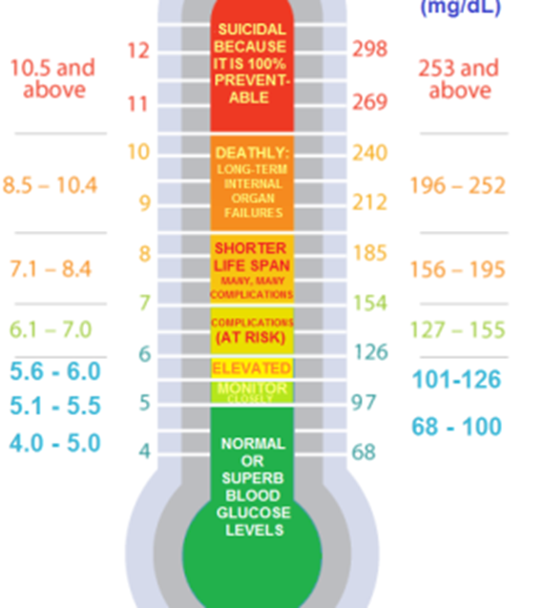
Mmol/L

Slide 28
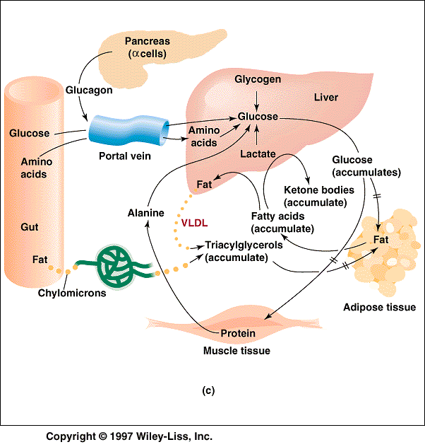
Insulin dependent diabetes mellitus

Slide 29
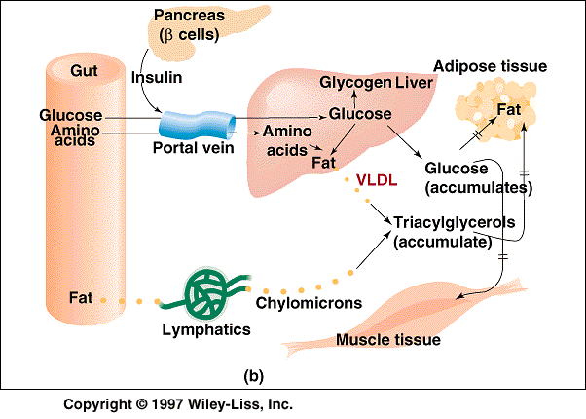
Insulin independent diabetes mellitus

Slide 30
Quiz 1: List out the role and properties of following metabolic intermediates:
Pyruvate,
Acetly-CoA
Glucose-6 phosphate
Ala and Gln
glycerol and Glycerol-3 phosphate
lactate
NADH and NADPH

Slide 31
Quiz 2
List out the enzymes allosterically affected during fasting state!
Name their allosterical effectors!

