Slide 1
Synthesis of saturated and unsaturated (ω-9, ω-6, ω-3 series) FAs and Eicosanoids, triacylglycerols and Phospholipids
Associate Professor .dr. sc. Daria Pašalić

Slide 2
Basic topics
Fatty acid biosynthesis precursors
Enzyme-complex fatty acid-synthase
Specific reactions of biosynthesis
Desaturation
Eicosanoids
Biosynthesis of triacylglycerol

Slide 3
Biosynthesis of fatty acids
The role of biosynthesis of fatty acids
  For energy storage
  For membrane structures
Biosynthesis is endogenous and reductive –(ATP and NADPH expenditure)
Cellular localization: Cytosol
Specificity: 3C-intermedier required for synthesis (Malonyl-CoA)

Slide 4
Two enzymes for synthesis of palmitate (C-16 fatty acid)
acetyl-CoA-carboxylase
acyl-CoA synthase- complex

Slide 5

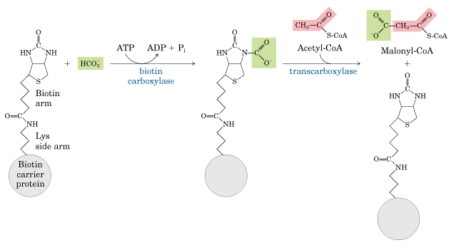
1. Malonyl-CoA synthesis
acetyl-CoA-carboxylase – multifunctional polypeptide
KEY regulatory reaction

Slide 6
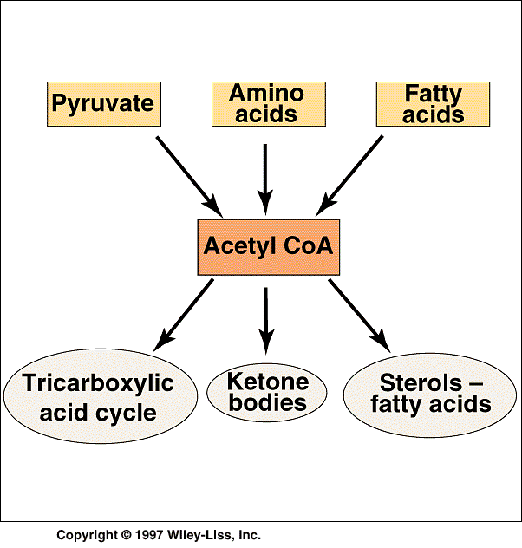
Acetyl-CoA –
Glycolysis
T. E. Devlin: Textbook of Biochemistry with Clinical Correlations, John Wiley and Sons Inc., 2002

Slide 7
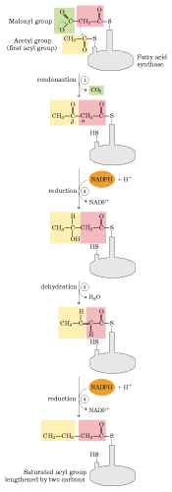
2. Biosynthesis of fatty acid from malonyl-CoA and acetyl-CoA on the complex acyl-CoA synthase complex include four reactions:
A-Condensation
B-Reduction
C-Dehydration
D-Reduction
Coenzyme for two reduction rections: NADPH
Activating groups: two –SH groups on enzyme
(Cysteinyl- for acetyl group and ACP for malonyl group)

Slide 8
3. β-ketoacyl-ACP
synthase
2. Malonyl-CoA-ACP
transferase
KS
MT
AT
KR
ER
HD
1. Acetyl (Acyl) CoA-ACP
transacetylase.
4.β-ketoacyl-ACP
reductase
6-β-enoyl-ACP
reductase
5.β-hydroxyacyl-ACP
dehydratase

Slide 9
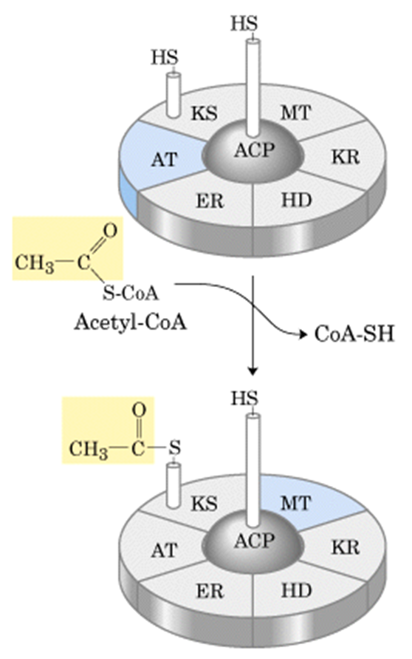
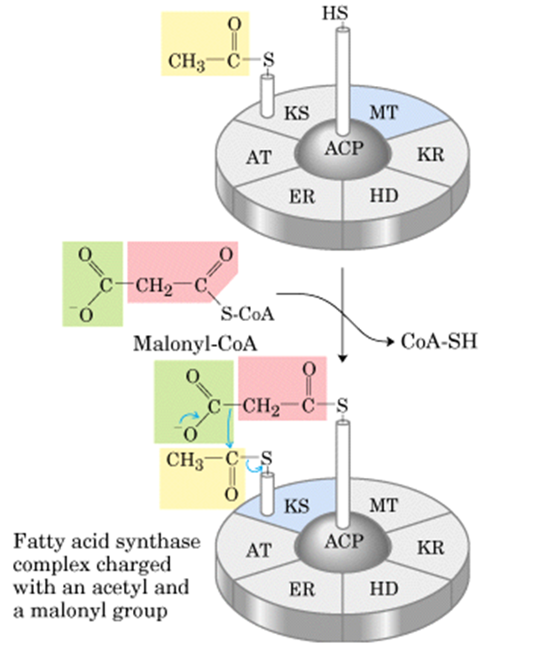
Acyl-Co synthase complex at first binds acetyl- and malonyl- groups
1. AT – Acetyl (Acyl) CoA-ACP transacetylase
  Transfer acetyl-group on:
    KS - β-ketoacyl-ACP- synthase (HS- group of Cys residue)
2. MT- Malonyl-CoA-ACP transferase
  -Transfer malonyl-group on:
ACP- acyl-carrier-protein
(HS-group of 4-phosphopantetheine-prostetic group)

Slide 10
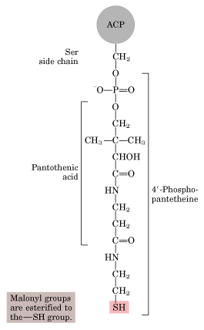
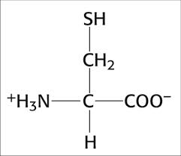
Acety (Acyl) groups are esterified to the –SH group

Slide 11
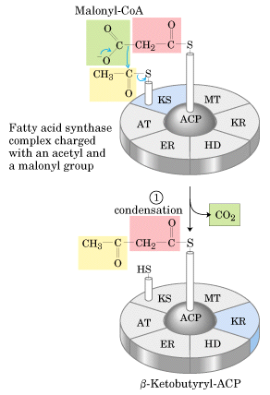
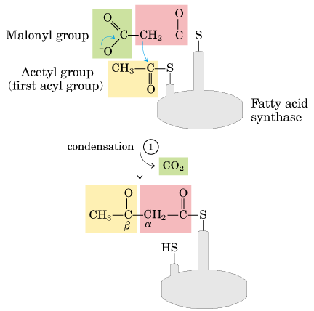
3.KS - β-ketoacyl-ACP-synthase

Slide 12
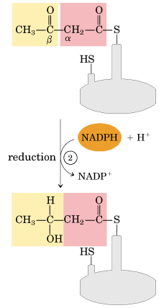
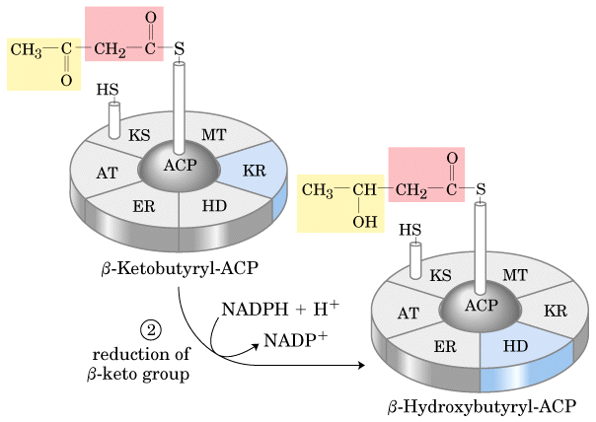
4. KR - β-ketoacyl-ACP-reductase
The -keto group is reduced to an alcohol.

Slide 13
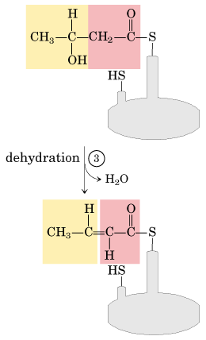
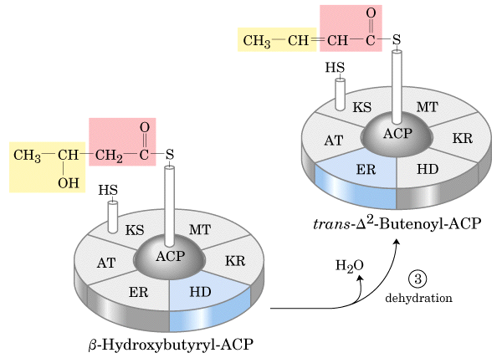
5. HD - β-hydroxyacyl-ACP-dehydratase
Elimination of H2O creates a double bond.

Slide 14
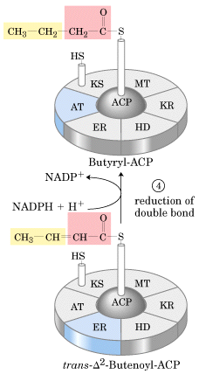
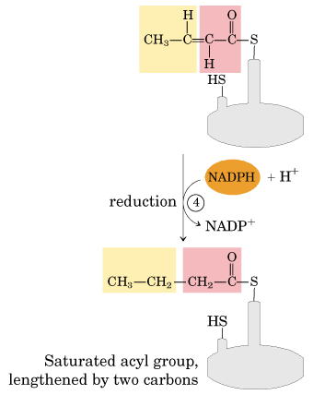
6. ER- β-enoyl-ACP-reductase
double bond is reduced to form the corresponding saturated fatty acyl group.

Slide 15
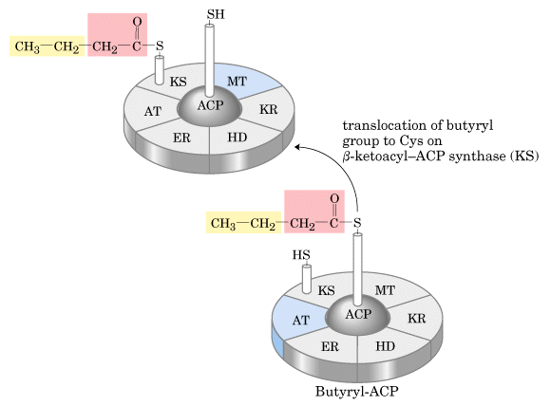
Transfering of butyril-residue from ACP at KS
Prior the next step the butyryl group is translocated on the Cys -SH group.

Slide 16
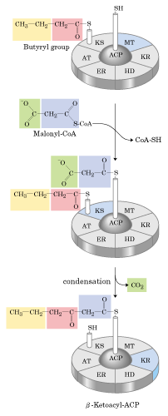

Prior the next step the butyryl group is translocated on the Cys -SH group.
Second round of byosynthesis

Slide 18
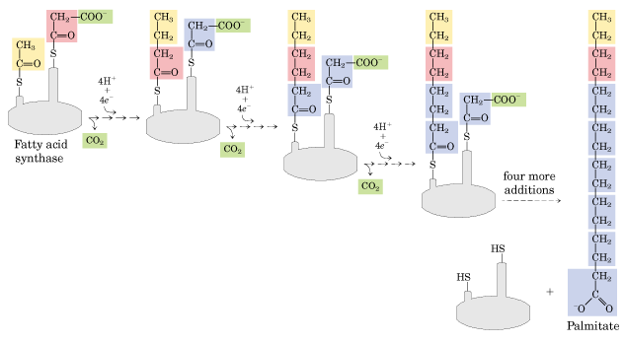
The overall process of palmitate synthesis

Slide 19
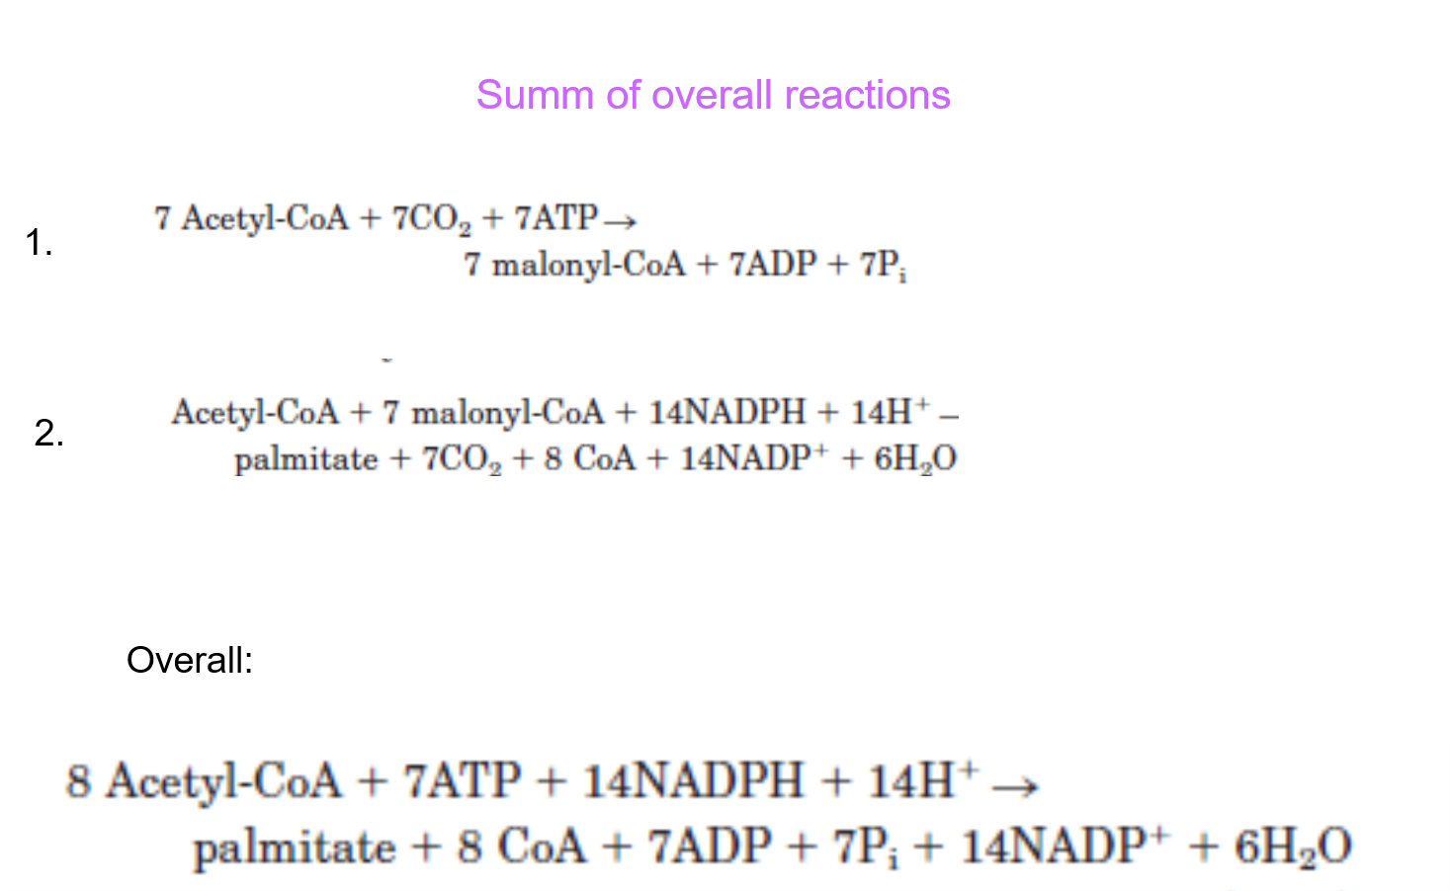

Slide 20
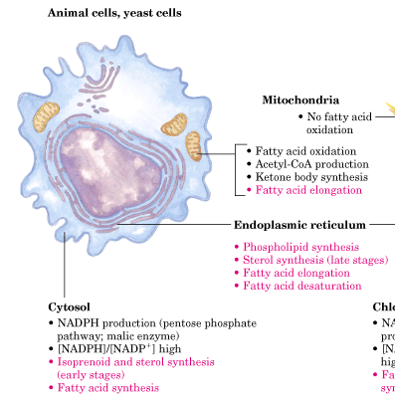
Subcellular localization
Fatty acid biosynthesis of palmitate (16 C atoms compound) is localized in cytosol.
Elongation of fatty acids- biosynthesis of fatty acids with more than 16 C-atoms, is localized in endoplasmatic reticulum and mitochondrion.
Fatty acid synthesis takes place in the compartment
in which NADPH is available for reductive synthesis

Slide 21
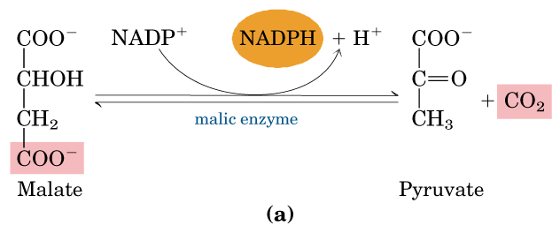
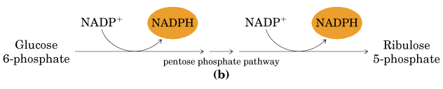
Production of NADPH necessary for reductive synthesis
In hepatocytes and adipocytes-both pathways
In hepatocytes and mammary glands in lactation- pentose phosphate pathway

Slide 22
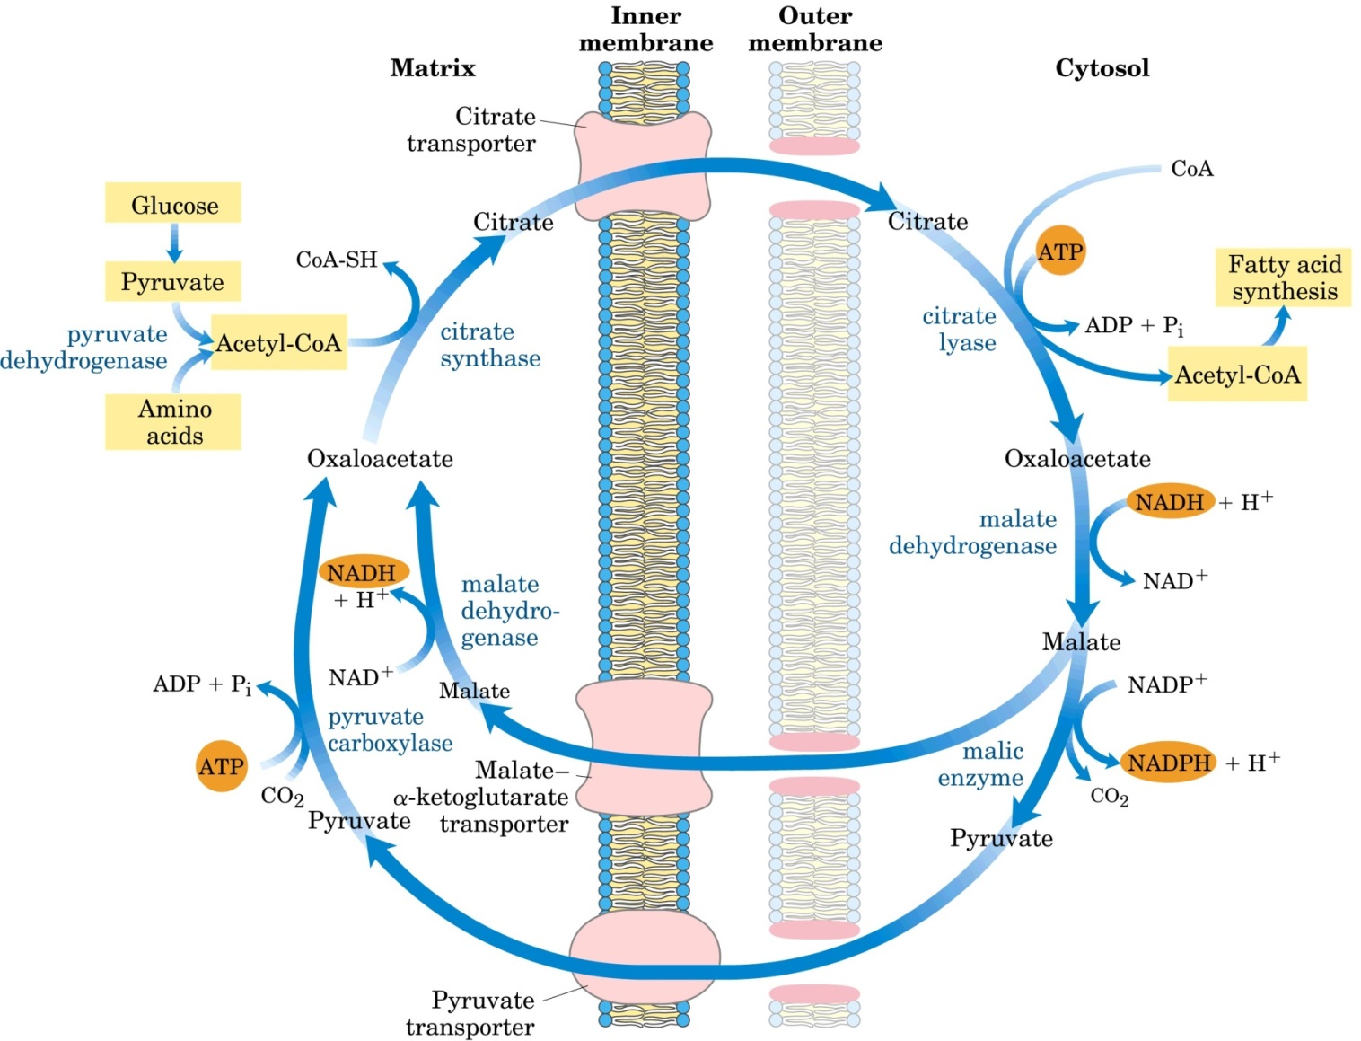
Shuttle for transfer of acetyl groups from mitochondria
MALATE-CITRATE SHUTLE
Cytosol

Slide 23
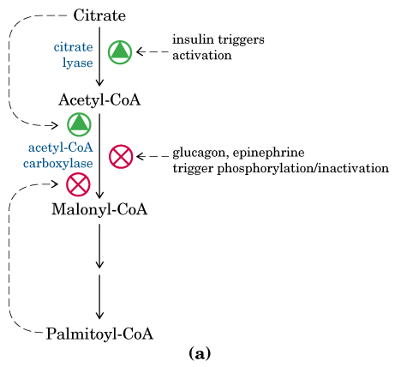
Regulation
At the same time inhibits PFK1
allosteric
Insulin activates the carboxylase, whereas glucagon and epinephrine -inhibit
Citrate,-a signal that building blocks and energy are abundant, activates the carboxylase. Palmitoyl CoA and AMP- lead to the inhibition of the carboxylase.
Rate limiting enzyme
Inhibits β oxidation (carnitine acyl transferase I)
Feed-back mechanism

Slide 24
Phosphorylation of carboxylase
HORMONAL REGULATION
Epinephrine and glucagon activate Protein kinase A-PKA; PKA phosphorylates Acetyl Co carboxylase- and therefore inhibit the enzyme.
Oppositely Insulin activate the cascade which assure dephosphorylation of Acetyl-CoA carboxylase and therefore activates the enzyme
In starvation, the level of free fatty acids rises because hormones such as epinephrine and glucagon stimulate adipose-cell lipase.

Slide 25
Local Regulation.
-allosterically stimulated by citrate:
-citrate partly reverses the inhibition produced by phosphorylation
-The level of citrate is high when both acetyl CoA and ATP are abundant. -mammalian isocitrate dehydrogenase (CLK) -inhibited by a high energy charge
-high level of citrate signifies that two-carbon units and ATP are available for fatty acid synthesis.
-allosterically inhibited by palmitate
-The stimulatory effect of citrate on the carboxylase is antagonized by palmitoyl CoA, which is abundant when there is an excess of fatty acids.
-Palmitoyl CoA also inhibits the translocase that transports
citrate from mitochondria to the cytosol
-inhibits also glucose 6-phosphate dehydrogenase, which generates NADPH in the pentose phosphate pathway.

Slide 26
Response to Diet
Starvation, the level of free fatty acids rises- hormones such as epinephrine and glucagon stimulate adipose-cell lipase.
Well feed state- insulin, inhibits lipolysis.
Malonyl CoA ( a product of acetyl CoA carboxylase
- increases when fuel molecules are abundant
- inhibits carnitine acyltransferase I, preventing access of fatty acyl CoAs to the mitochondrial matrix
-especially effective inhibitor of carnitine acyltransferase I in heart and
muscle, tissues that have little fatty acid synthesis capacity of their own.
-
Long-term control or adaptive control
-mediated by changes in the rates of synthesis and degradation of the enzymes participating in fatty acid synthesis.
(Animals that have fasted and are then fed high-carbohydrate, low-fat diets show marked increases in their amounts of acetyl CoA carboxylase and fatty acid synthase within few days.)

Slide 27
Elongation
Providing of all other longer fatty acids from palmitate
System of fatty acid elongation is localized on smooth ER and inside mitochondrion
CoA is fatty acid carrier (no ACP)
ER- (separate enzymes)
    2C unit is added from malony-CoA,
    Reduction
    Dehydration
    Reduction

Slide 28
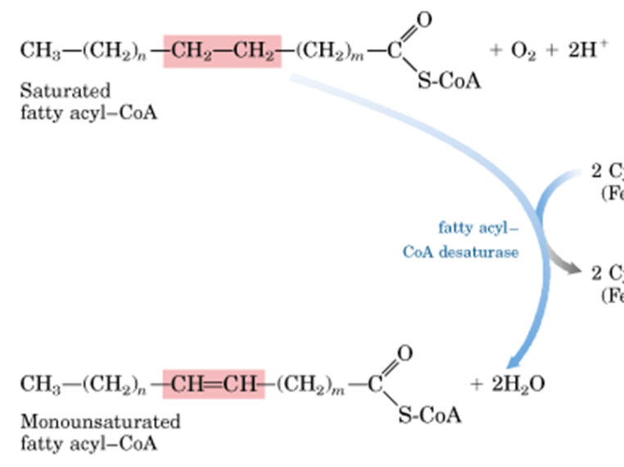
Desaturation
Palmitate and stearate are precursors of palmitoleate 16:1(Δ⁹)-ω6 and oleate 18:1(Δ⁹)ω9
    Cis double bond on Δ⁹
    Mixed function oxidase
      fatty acyl-CoA desaturase
Human hepatocytes can introduce double bonds only until and at Δ⁹ (between 9th and 10th carbon atom), but cannot between C-10 and the methyl-terminal end

Slide 29
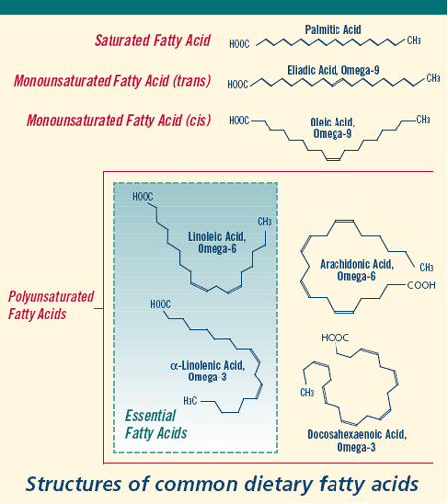
16:1;9 palmitoleic (cis-9-hexadecenoic) 16:1n-7 (ω-7)
18:1;9 oleic ( cis-9-octadecenoic) 18:1n-9 (ω-9)
18:1;9 elaidic (trans-9-octadecenoic) 18:1n-9 (ω-9)
18:2;9,12 linoleic (all-cis-9,12-octadecadienoic) 18:2n-6 (ω-6)
18:3;9,12,15 α-linolenic (all-cis-9,12,15-octadecatrienoic) 18:3n-3 (ω-3)
18:3;6,9, 12 γ -linolenic (all-cis-6, 9,12 octadecatrienoic) 18:3n-6 (ω-6)
20:4;5,8,11,14 arachidonic (all-cis-5,8,11,14-eicosatetraenoic) 20:4n-6 (ω-6)

Slide 30
Essential fatty acids
linoleic 18:2(Δ^{9,12}) and α-linolenic 18:3(Δ^{9,12,15}) cannot be produced in human
γ-linolenic 18:3(Δ^{6,9,12}) can be produced from linoleic 18:2(Δ^{9,12}) by desaturases
Arachidonic 20:4 (Δ^{5,8,11,14} ) can be produced from γ-linolenic 18:3(Δ^{6,9,12}) by elongase and desaturase

Slide 31
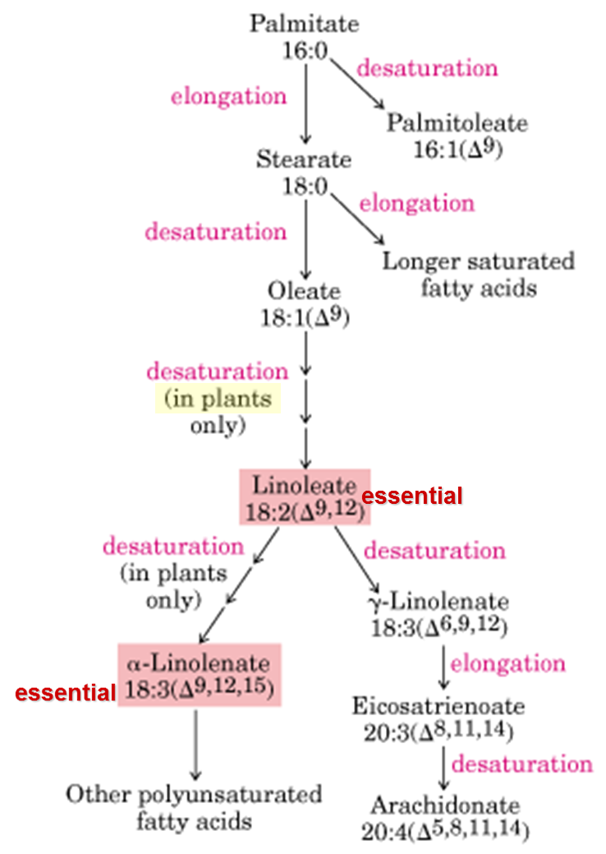
1 Arachidonate synthesis (de novo)

Slide 32
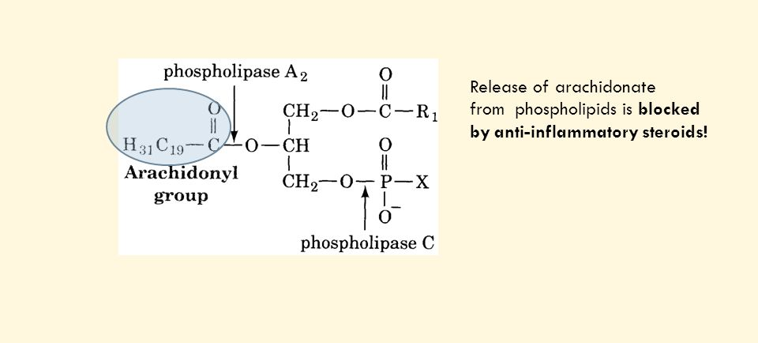
2 Arachidonate- mobilization for eicosanoid synthesis
-acts only on cells near the point of synthesis
-involved in reproductive function, inflammation, fever, pain, blood clots, blood pressure, gastric secretion etc.
All are derivatives of 20- C polyunsaturated arachidonic acid 20: 4 (Δ^{5,8,11,14})
released from membrane phospholipids by activity of phospholipase A₂

Slide 33
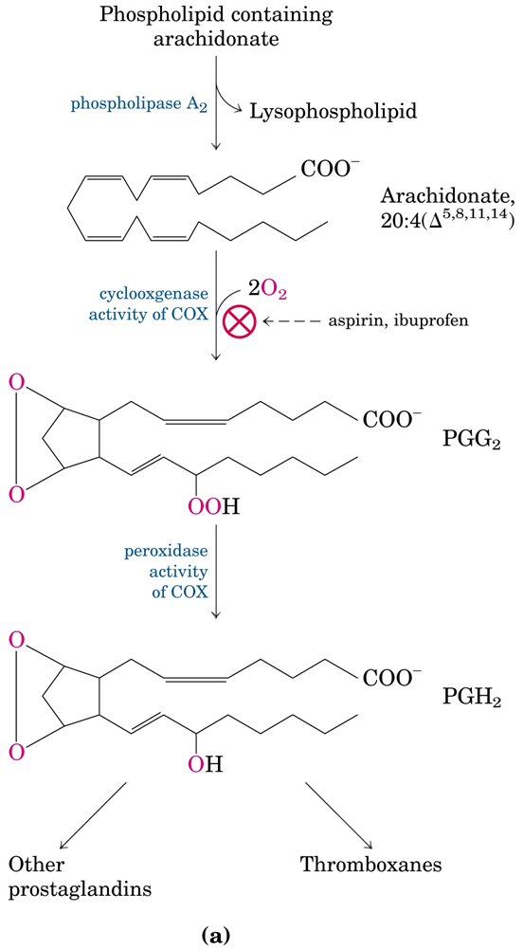
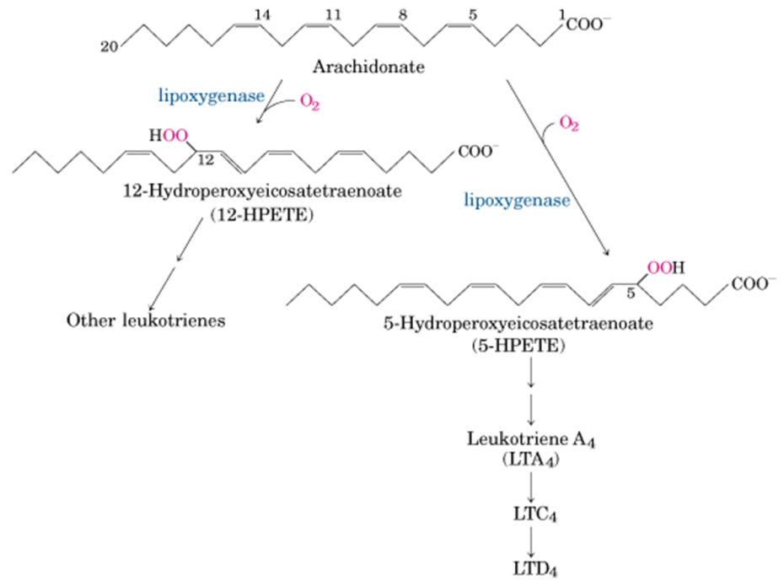
Eicosanoids-paracrine hormones
Prostaglandins
-almost all tissues (except RBC)
-regulate synthesis of cAMP
-contraction of smooth muscle cells (menstruation, labor)
-affect blood flow od specific organs
-wake-sleep cycle
-inflammation, pain, fever
Thromboxane synthase( thrombocytes)
-constriction of blood vessels; platelet aggregation
Leukotrienes
Lipoxygenase-WBCs, heart, brain, lung, spleen
-Allergic reactions
-Contraction of muscle lining the airways to the lung

Slide 34
Triacylglycerol and phospholipid biosynthesis
Fatty acids from food
    Metabolic energy storage (TG)
    Membrane structures(PL)
Triacylglycerol and glycerophospholipids
  The same precursor phosphatidic acid
In animal tissues, triacylglycerol's and glycerophospholipids such as phosphatidylethanolamine share two precursors (fatty acyl–CoA and L-glycerol 3-phosphate) and several biosynthetic steps.

Slide 35
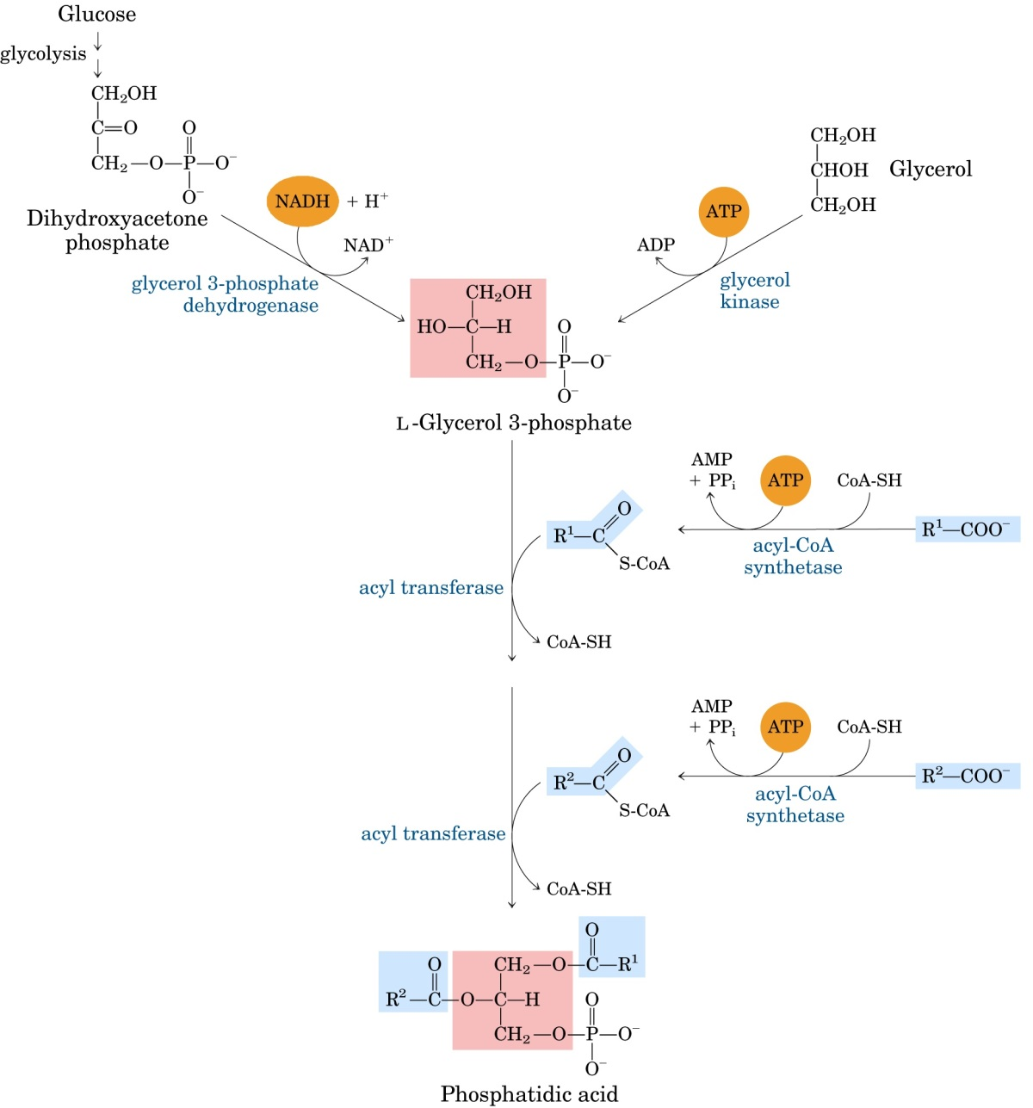
Liver and kidney
Adipose tissue

Slide 36
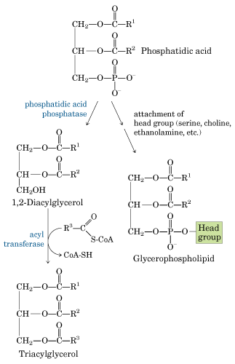

Slide 37
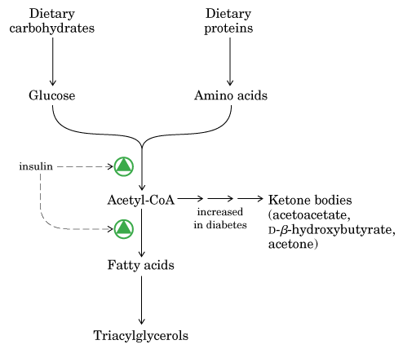
Regulation of TG biosynthesis
redundant carbohydrate, fat and protein- storage in TG
Insulin -- induce conversion of carbohydrates to TGs (Adipocytes and liver)
Glucagon (degradation of TGs- hormone sensitive lipase)
Growth hormone (degradations of fat)

Slide 38
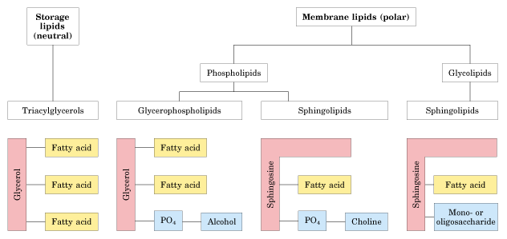
Slika izvor: D. L. Nelson, M. M. Cox: Lehninger Principles of Biochemistry.Worth Publishers; New York 2006.

Slide 39
1. Represent by structural formulas reaction STEPS in biosynthesis of palmitate starting from:
c4 to synthetize c6
2. Which coenzymes are necessary for biosynthesis of fatty acids?
3. Please list the enzyme active sited on the fatty acid synthase complex!
4.Which is the key regulatory enzyme of fatty acid biosynthesis? Please list allosteric effectors that regulate this enzyme activity?
5. How can you shortly explain the influence of insulin and glucagon on the FFA biosynthesis?
6. What are eicosanoids?

